Slide 1
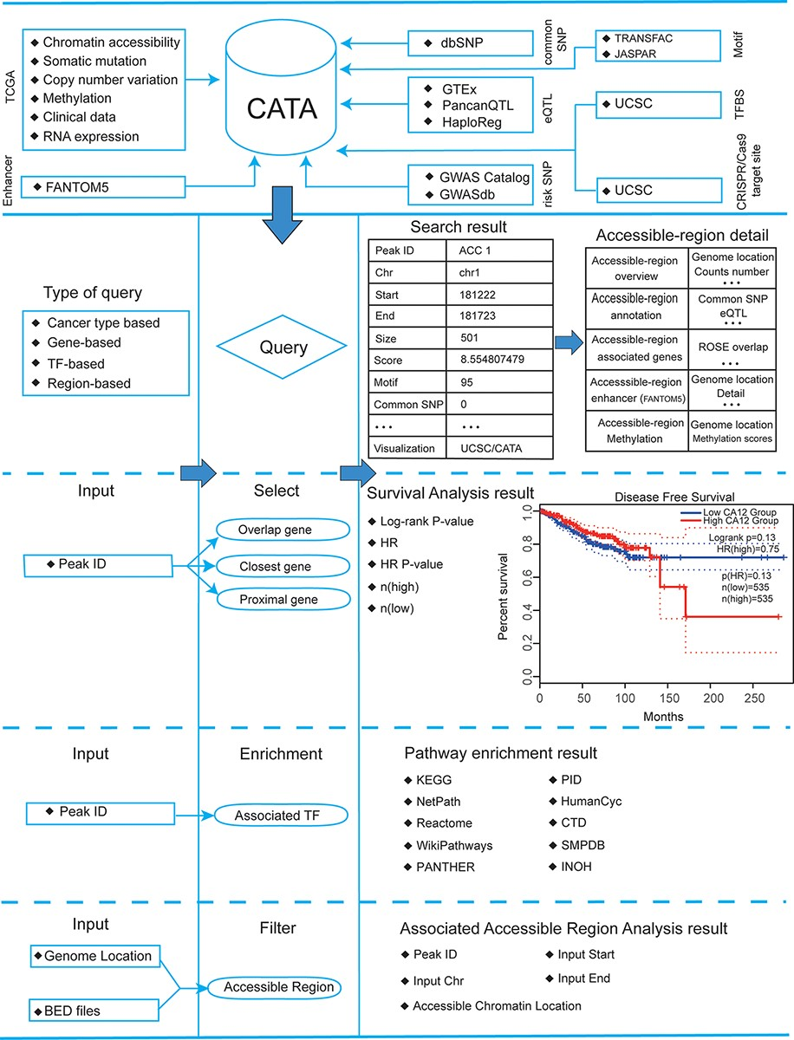
Figure 2. Database content and construction. CATA provides chromatin-accessible regions of cancer-based on TCGA ...
Notes:
Figure 2. Database content and construction. CATA provides chromatin-accessible regions of cancer-based on TCGA ATAC-seq data. Genetic and epigenetic annotations of accessible regions were collected or calculated including common SNPs, eQTLs, risk SNPs, LD SNPs, TFBS, CNV, SNV, methylation sites and enhancer location. CATA also provides ATAC-seq samples associated with clinical data. CATA integrates multiple functions including storage, search, download, statistics, visualization, browse and analysis.
Unless provided in the caption above, the following copyright applies to the content of this slide: © The Author(s) 2022. Published by Oxford University Press.This is an Open Access article distributed under the terms of the Creative Commons Attribution License (https://creativecommons.org/licenses/by/4.0/), which permits unrestricted reuse, distribution, and reproduction in any medium, provided the original work is properly cited.

