Slide 1
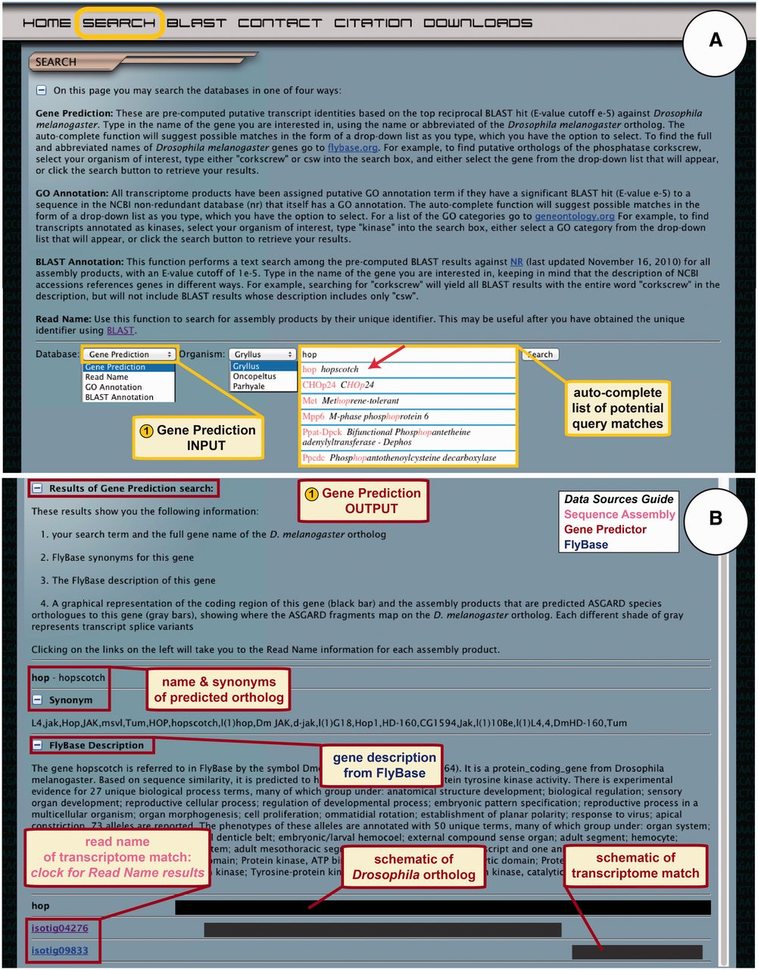
Figure 3 ASGARD Gene Prediction search. The search page gives users access to the Gene Prediction, Read Name, GO ...
Notes:
Figure 3 ASGARD Gene Prediction search. The search page gives users access to the Gene Prediction, Read Name, GO Annotation and BLAST Annotation search functions. (A) The input user interface allows users to choose an organism of interest and enter query terms based on D. melanogaster gene names. While entering the search term, users are assisted by an auto-completed list of suggested matching gene names. In this example, a user searching for G. bimaculatus orthologs of Janus kinase (JAK) has begun to enter the name of the D. melanogaster JAK ortholog ‘hopscotch’, which obtained an exact match in the auto-completion list (arrow). (B) The output of the gene prediction search shows predicted ortholog matches, a description of the D. melanogaster gene, schematic representations of and links to matching assembly products.
Unless provided in the caption above, the following copyright applies to the content of this slide: © The Author(s) 2012. Published by Oxford University Press.This is an Open Access article distributed under the terms of the Creative Commons Attribution License (http://creativecommons.org/licenses/by-nc/3.0/), which permits non-commercial reuse, distribution, and reproduction in any medium, provided the original work is properly cited. For commercial re-use, please contact journals.permissions@oup.com.

