Slide 1
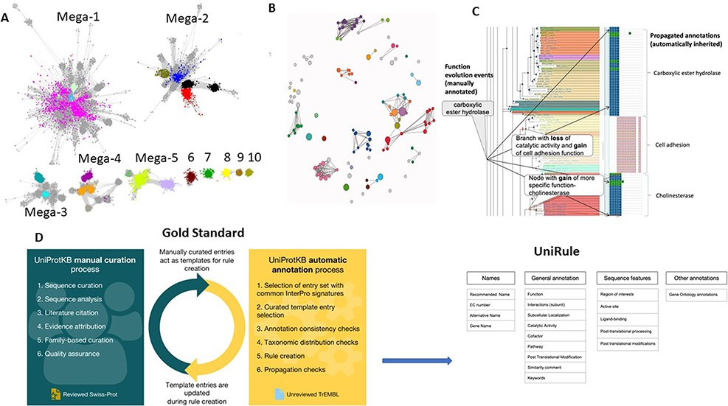
Figure 1. Different existing resources to separate isofunctional families. The top three panels show different methods ...
Notes:
Figure 1. Different existing resources to separate isofunctional families. The top three panels show different methods based on sequence similarities to try and identify subgroups. The bottom panel focuses on rule-based approaches. (A) SSN example from RadicalSAM.org with protein as nodes linked by an edge if they are similar within a certain threshold that shows the separation of the members of the Radical SAM superfamily; some subgroups cannot be separated as seen in Megaclusters 1–5; some are distinct as seen in Clusters 6–10; (B) network representation of the HIGH-signature proteins, UspA, and PP-ATPase (HUP) Superfamily (CATH 3.40.50.620) showing available functional annotations in FunFams. The colored nodes indicate FunFams annotated with different EC numbers, and the gray nodes indicate FunFams without any EC annotation, which includes nonenzymes [Figure from (127)]; (C) GO Phylogenetic Annotation: annotations of gains and losses of functions on ancestral nodes in the tree, based on experimental annotations (left) lead to different function annotations of uncharacterized proteins depending on their evolutionary history (right); (D) UniRule generation platform.
Unless provided in the caption above, the following copyright applies to the content of this slide: © The Author(s) 2022. Published by Oxford University Press.This is an Open Access article distributed under the terms of the Creative Commons Attribution-NonCommercial License (https://creativecommons.org/licenses/by-nc/4.0/), which permits non-commercial re-use, distribution, and reproduction in any medium, provided the original work is properly cited. For commercial re-use, please contact journals.permissions@oup.com

Slide 2
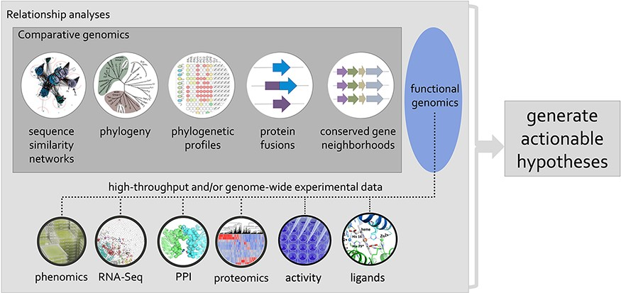
Figure 3. Using phylogenetic relationships to guide the integration of data associated with related proteins, mining of ...
Notes:
Figure 3. Using phylogenetic relationships to guide the integration of data associated with related proteins, mining of genomic and post-genomic data can seed defined hypotheses for the discovery of molecular and biological functions associated with genes/proteins of unknown or uncertain function.
Unless provided in the caption above, the following copyright applies to the content of this slide: © The Author(s) 2022. Published by Oxford University Press.This is an Open Access article distributed under the terms of the Creative Commons Attribution-NonCommercial License (https://creativecommons.org/licenses/by-nc/4.0/), which permits non-commercial re-use, distribution, and reproduction in any medium, provided the original work is properly cited. For commercial re-use, please contact journals.permissions@oup.com

Slide 3
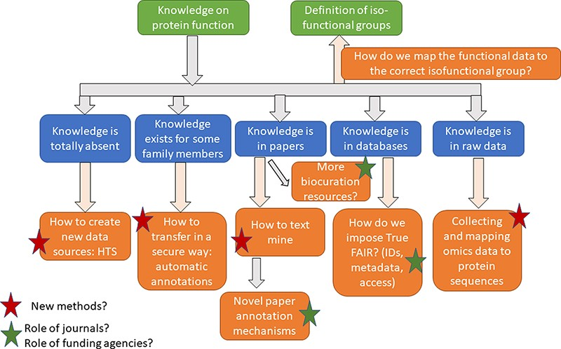
Figure 4. Questions discussed during the five sessions.
Notes:
Figure 4. Questions discussed during the five sessions.
Unless provided in the caption above, the following copyright applies to the content of this slide: © The Author(s) 2022. Published by Oxford University Press.This is an Open Access article distributed under the terms of the Creative Commons Attribution-NonCommercial License (https://creativecommons.org/licenses/by-nc/4.0/), which permits non-commercial re-use, distribution, and reproduction in any medium, provided the original work is properly cited. For commercial re-use, please contact journals.permissions@oup.com

Slide 4
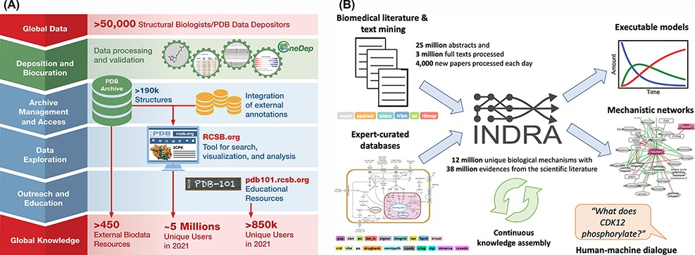
Figure 2. (A) RCSB PDB converts global data into global knowledge. (B) INDRA performs knowledge assembly from the ...
Notes:
Figure 2. (A) RCSB PDB converts global data into global knowledge. (B) INDRA performs knowledge assembly from the biomedical literature and expert-curated databases into a knowledge base of mechanistic statements that can be converted into models and networks and queried through human–machine dialogue.
Unless provided in the caption above, the following copyright applies to the content of this slide: © The Author(s) 2022. Published by Oxford University Press.This is an Open Access article distributed under the terms of the Creative Commons Attribution-NonCommercial License (https://creativecommons.org/licenses/by-nc/4.0/), which permits non-commercial re-use, distribution, and reproduction in any medium, provided the original work is properly cited. For commercial re-use, please contact journals.permissions@oup.com

