Slide 1
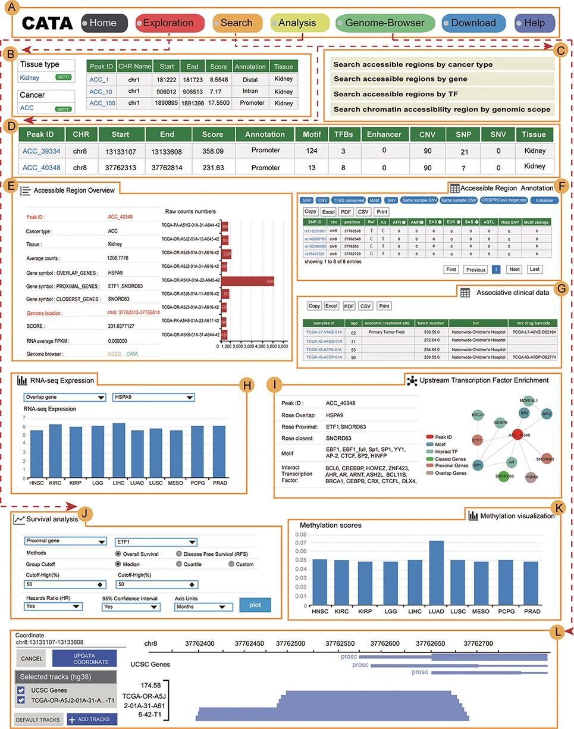
Figure 3. The main function and usage of CATA. (A) The navigation bar of CATA. (B) CATA provides user’s friendly ...
Notes:
Figure 3. The main function and usage of CATA. (A) The navigation bar of CATA. (B) CATA provides user’s friendly explorations. (C) Users can query using five methods: ‘Search by Cancer type’, ‘Search by gene’, ‘Search by TF’ and ‘Advanced search by genome location’. (D) The display of search results. (E) Overview of chromatin-accessible regions. The y-axis is the patient ID provided by TCGA. The x-axis is the count number that is the raw read count of ATAC-seq in the Peak ID. (F) Interactive table of chromatin-accessible region, related annotation information. (G) The table of clinical data. (H) The visualization of RNA-expression. (I) Upstream TF enrichment graph. (J) The overall survival and disease-free survival analysis of the interest gene can be presented in the ‘Survival’ region. Meanwhile, genes with the most significant association with patient survival can be identified. (K) The visualization of the methylation level. (L) Personalized genome browser-GIVE.
Unless provided in the caption above, the following copyright applies to the content of this slide: © The Author(s) 2022. Published by Oxford University Press.This is an Open Access article distributed under the terms of the Creative Commons Attribution License (https://creativecommons.org/licenses/by/4.0/), which permits unrestricted reuse, distribution, and reproduction in any medium, provided the original work is properly cited.

