Slide 1
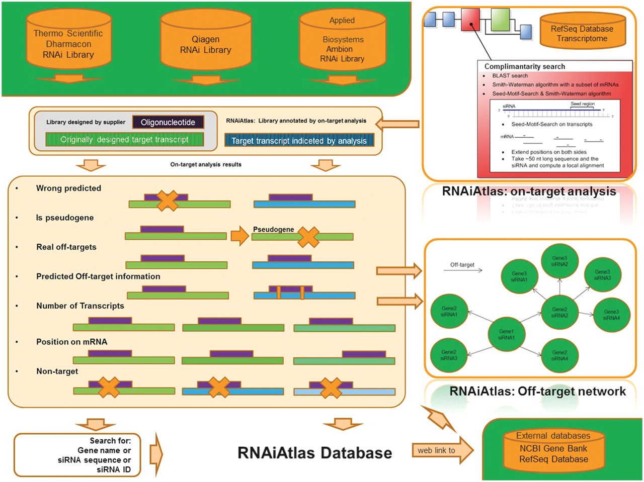
Figure 1 Overview of RNAiAtlas database content. The re-annotation of commercially available human genome-wide siRNA ...
Notes:
Figure 1 Overview of RNAiAtlas database content. The re-annotation of commercially available human genome-wide siRNA (three human, genome-wide) libraries with different NCBI reference sequences (RefSeq) were collected in a database. On-target analysis calculations were performed using a dedicated design/evaluation pipeline to quantitatively assess the specificity of the constructs. Interactive network visualization allows the inspection of the off-target network between an siRNA and its target genes.
Unless provided in the caption above, the following copyright applies to the content of this slide: © The Author(s) 2012. Published by Oxford University Press.This is an Open Access article distributed under the terms of the Creative Commons Attribution Non-Commercial License (http://creativecommons.org/licenses/by-nc/3.0), which permits unrestricted non-commercial use, distribution, and reproduction in any medium, provided the original work is properly cited.

Slide 2
Figure 2 Example of selected siRNAs and their on-target analysis results are shown from Qiagen, Ambion and Dharmacon ...
Notes:
Figure 2 Example of selected siRNAs and their on-target analysis results are shown from Qiagen, Ambion and Dharmacon libraries, analyzed with RefSeq 2012. The columns can be classified into five functional groups that contain information about: original target, transcripts information, off-targets, wrong predicted and on-target. The table illustrates all possible on-target analysis results that are incorporated into RNAiAtlas. The table data is generated off-line and fed into RNAiAtlas.
Unless provided in the caption above, the following copyright applies to the content of this slide: © The Author(s) 2012. Published by Oxford University Press.This is an Open Access article distributed under the terms of the Creative Commons Attribution Non-Commercial License (http://creativecommons.org/licenses/by-nc/3.0), which permits unrestricted non-commercial use, distribution, and reproduction in any medium, provided the original work is properly cited.

Slide 3
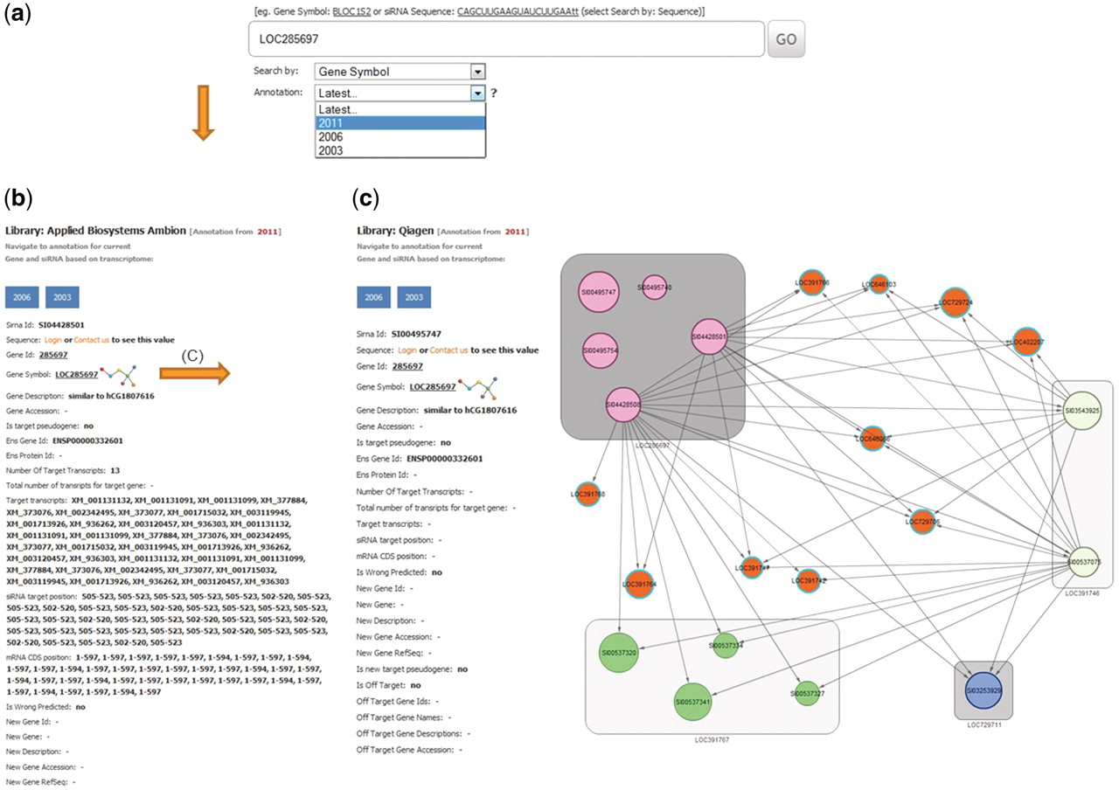
Figure 3 Example of a database search for gene LOC285697. (a) The search page allows for gene, siRNA sequence or siRNA ...
Notes:
Figure 3 Example of a database search for gene LOC285697. (a) The search page allows for gene, siRNA sequence or siRNA ID. The search page provides a combo-box with selection possibility for the year of RefSeq database used for on-target analysis. Here LOC285697 as gene symbol was queried with the selected year of 2011 for RefSeq annotation. (b) Results card showing siRNAs, annotation for the queried gene and specificity parameters. (c) An example of the off-target network view in RNAiAtlas, centered on the query siRNA AGGCAGCAACAAGGATGGGAT (SI00495747) of gene ‘LOC285697’ from Qiagen human genome wide library (Network URL: http://rnaiatlas.ethz.ch/index/network/gene/LOC285697/library/3). Nodes in square (eg. gray squares) are individual siRNAs of same gene. Each node may have connection to off-target gene (represented again by three or four siRNAs). If off-targets genes are not existing in RNAiAtlas (e.g. pseudogenes, discontinued genes) siRNAs are having one edge to off-target gene (orange nodes).
Unless provided in the caption above, the following copyright applies to the content of this slide: © The Author(s) 2012. Published by Oxford University Press.This is an Open Access article distributed under the terms of the Creative Commons Attribution Non-Commercial License (http://creativecommons.org/licenses/by-nc/3.0), which permits unrestricted non-commercial use, distribution, and reproduction in any medium, provided the original work is properly cited.

