Slide 1
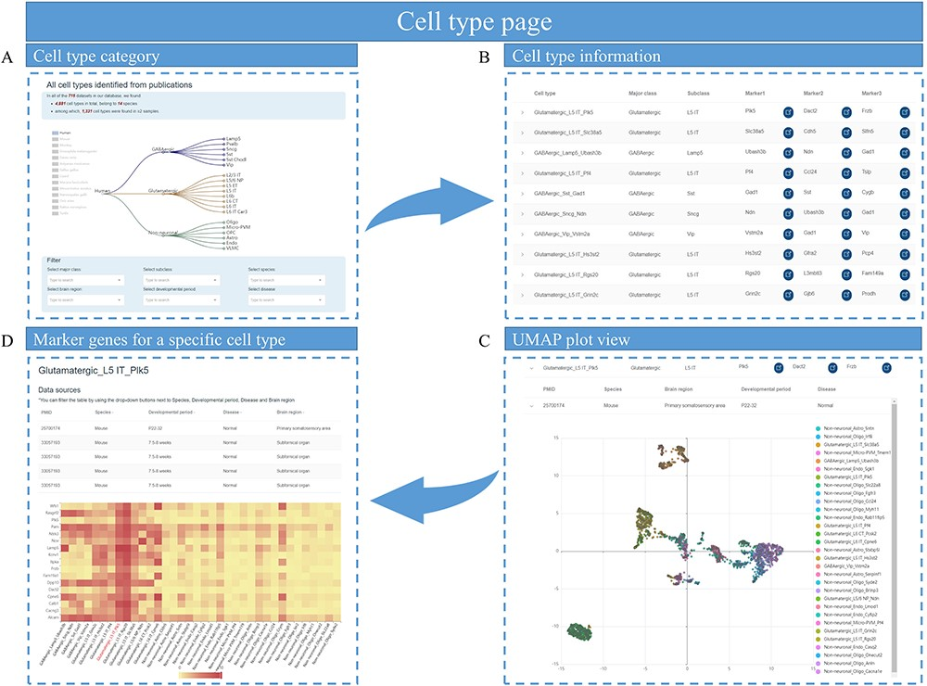
Figure 4. Cell types page of scBrainMap. (A) At the top of the page is a tree of major class and subclass cell types ...
Notes:
Figure 4. Cell types page of scBrainMap. (A) At the top of the page is a tree of major class and subclass cell types for each species. (B) The cell-type information table contains the name of the cell type, major class, cell subclass and their top marker genes. (C) An UMPA plot of single-cell clustering is displayed. (D) Heatmaps of DEG in cell types are visualized.
Unless provided in the caption above, the following copyright applies to the content of this slide: © The Author(s) 2023. Published by Oxford University Press.This is an Open Access article distributed under the terms of the Creative Commons Attribution License (https://creativecommons.org/licenses/by/4.0/), which permits unrestricted reuse, distribution, and reproduction in any medium, provided the original work is properly cited.

