Slide 1
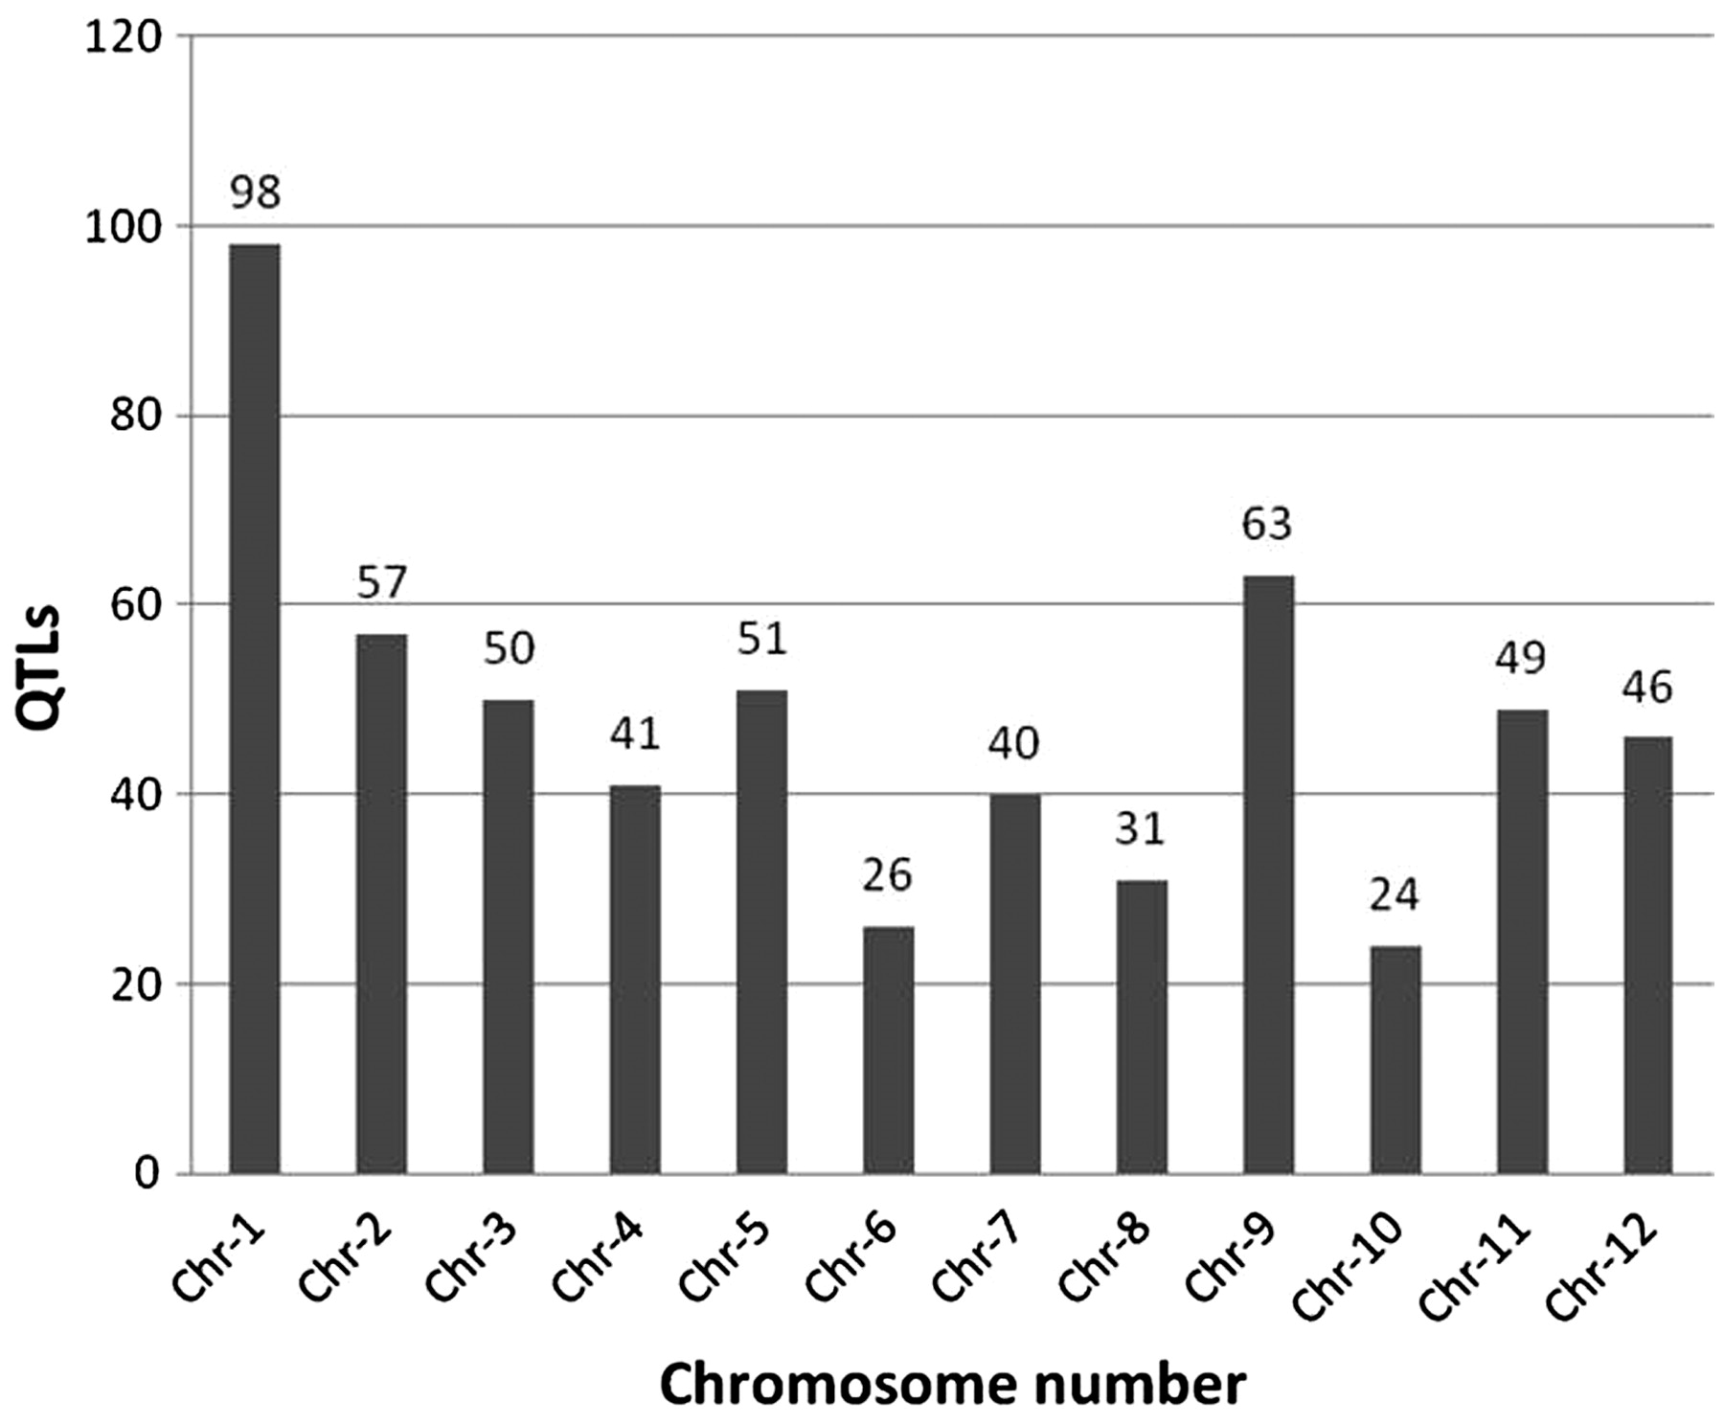
Figure 2. Overall distribution of 583 abiotic stress-associated QTLs scored for 53 traits mapped to 12 rice ...
Notes:
Figure 2. Overall distribution of 583 abiotic stress-associated QTLs scored for 53 traits mapped to 12 rice chromosomes, including those listed in Figure 1. Chromosome 1 has the highest number of identified QTLs (98) while chromosome 10 has the lowest (24).
Unless provided in the caption above, the following copyright applies to the content of this slide: © The Author(s) 2011. Published by Oxford University Press.This is Open Access article distributed under the terms of the Creative Commons Attribution Non-Commercial License (http://creativecommons.org/licenses/by-nc/2.5), which permits unrestricted non-commercial use, distribution, and reproduction in any medium, provided the original work is properly cited.

