Slide 1
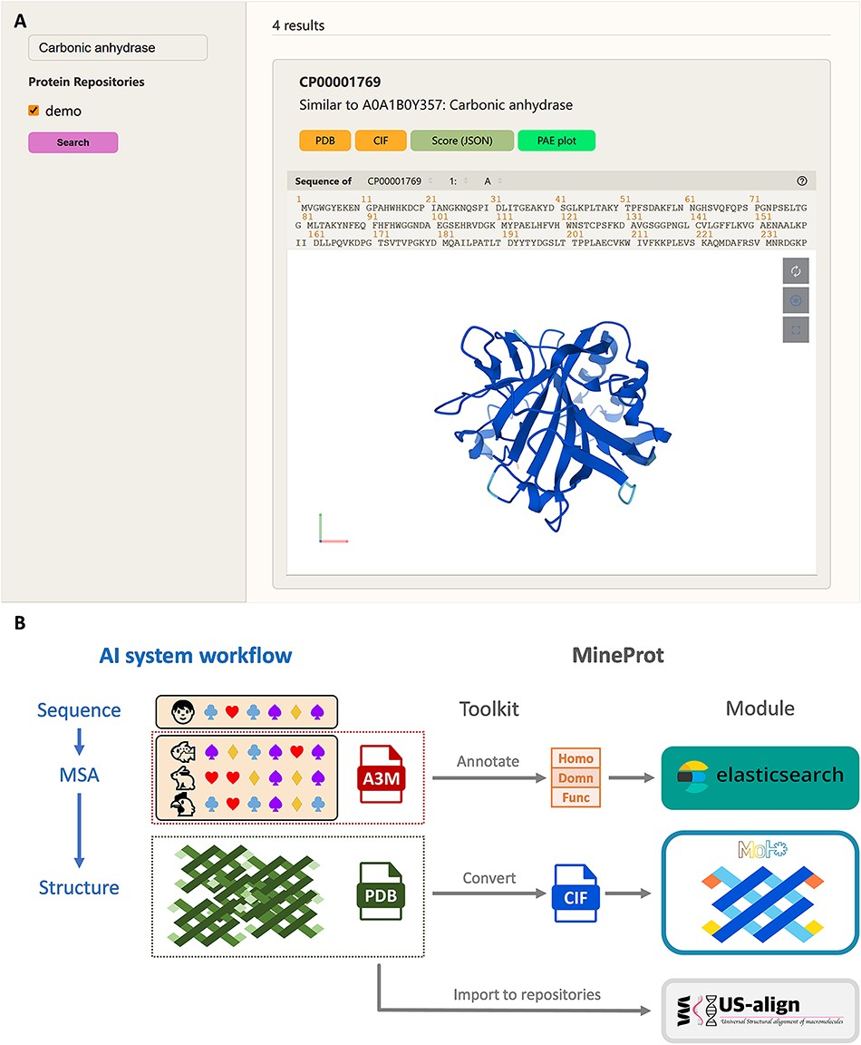
Figure 1. Demonstration of MineProt. (A) The Search Page of MineProt interface. Search scope can be restricted by ...
Notes:
Figure 1. Demonstration of MineProt. (A) The Search Page of MineProt interface. Search scope can be restricted by selecting repositories. The results will be demonstrated in the middle of the page, including annotation, Mol* structure visualization, and links to downloadable file. (B) Basic workflow of MineProt Toolkit. AlphaFold-like systems usually implement a ‘sequence-MSA-structure’ process. MineProt Toolkit uses MSA for homology-based annotation and added them into Elasticsearch indices for full-text searching, meanwhile it converts PDB files to CIF files supporting Mol* visualization. All usable data are finally imported into protein repositories on the server for curation and analysis.
Unless provided in the caption above, the following copyright applies to the content of this slide: © The Author(s) 2023. Published by Oxford University Press.This is an Open Access article distributed under the terms of the Creative Commons Attribution License (https://creativecommons.org/licenses/by/4.0/), which permits unrestricted reuse, distribution, and reproduction in any medium, provided the original work is properly cited.

