Slide 1
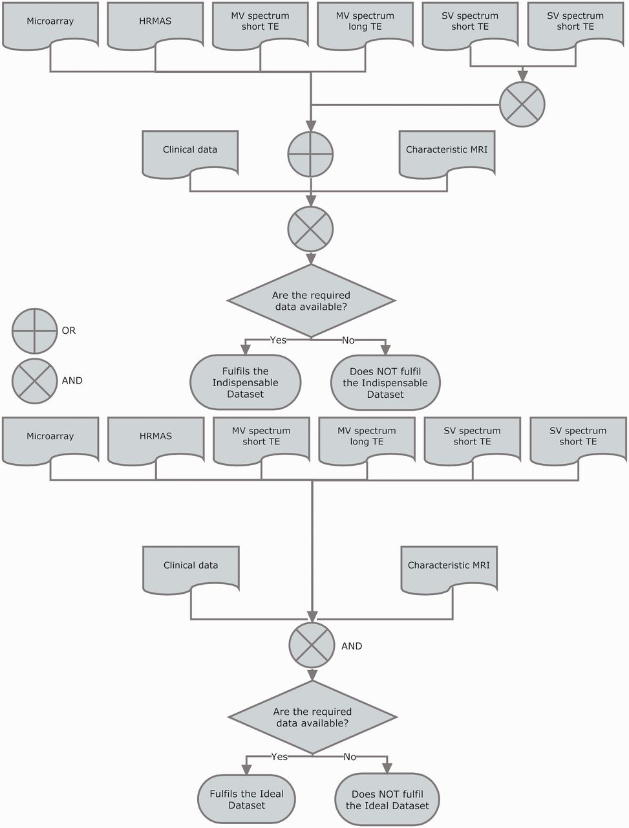
Figure 8 Indispensable (top) and ideal (bottom) datasets. For a case to fulfil the indispensable dataset, sufficient ...
Notes:
Figure 8 Indispensable (top) and ideal (bottom) datasets. For a case to fulfil the indispensable dataset, sufficient clinical information for performing the CDV had to be available. Sufficient clinical information was defined as the availability of: date of birth, sex, date of spectroscopy, at least one radiological classification (‘radiological diagnosis’ in the database), date of biopsy, paraffin section WHO (World Health Organization) classification (18, 19) (originating pathologist), relevant radiodiagnostic images [a representative T1-weighted image without contrast, a representative T2-weighted image and a representative image with voxel position(s) for the SV or the MV MRS]. In addition, the following data types were also needed to complete the indispensable dataset: one pair of MRS SV at short and long TE (except for rare cases such as childhood tumours and adults with small tumours where one echo time was acceptable), or one MRS MV at short TE, or one MRS MV at long TE, or HRMAS data, or one valid microarray.
Unless provided in the caption above, the following copyright applies to the content of this slide: © The Author(s) 2012. Published by Oxford University Press.This is an Open Access article distributed under the terms of the Creative Commons Attribution License (http://creativecommons.org/licenses/by-nc/3.0/), which permits non-commercial reuse, distribution, and reproduction in any medium, provided the original work is properly cited. For commercial re-use, please contact journals.permissions@oup.com.

