Slide 1
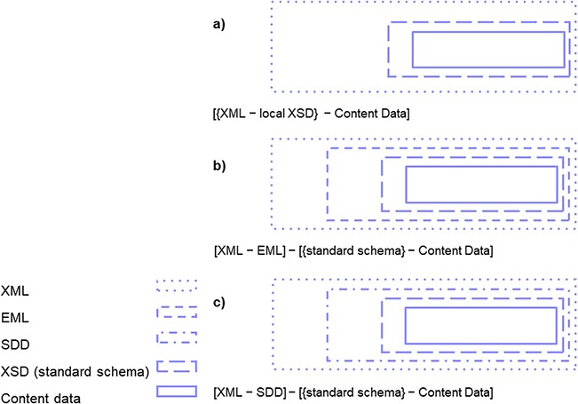
Figure 5 Research data export from DiversityDescriptions provided as XML files with content data with study ...
Notes:
Figure 5 Research data export from DiversityDescriptions provided as XML files with content data with study design-specific vocabulary provided in various formats: (a) as XML (with local XSD), (b) as XML-EML (and core elements mapped to any further domain standard schema) and (c) XML-SDD (and core elements mapped to any further domain standard schema).
Unless provided in the caption above, the following copyright applies to the content of this slide: © The Author(s) 2020. Published by Oxford University Press.This is an Open Access article distributed under the terms of the Creative Commons Attribution License (http://creativecommons.org/licenses/by/4.0/), which permits unrestricted reuse, distribution, and reproduction in any medium, provided the original work is properly cited.

