Slide 1
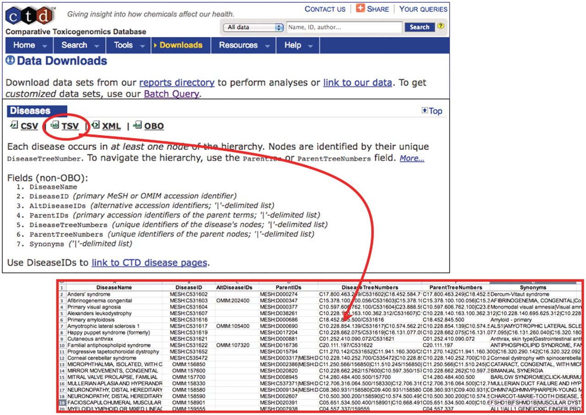
Figure 1. MEDIC is freely available from CTD. To obtain the most recent version of MEDIC, use the ‘Downloads’ menu tab. ...
Notes:
Figure 1. MEDIC is freely available from CTD. To obtain the most recent version of MEDIC, use the ‘Downloads’ menu tab. The vocabulary can be downloaded in various formats including CSV, TSV (red circle and inset), XML and OBO. We encourage other databases that use MEDIC to provide a direct link from their disease page to CTD’s equivalent disease page to promote interoperability between databases.
Unless provided in the caption above, the following copyright applies to the content of this slide: © The Author(s) 2012. Published by Oxford University Press.This is an Open Access article distributed under the terms of the Creative Commons Attribution Non-Commercial License (http://creativecommons.org/licenses/by-nc/3.0), which permits unrestricted non-commercial use, distribution, and reproduction in any medium, provided the original work is properly cited.

