Slide 1
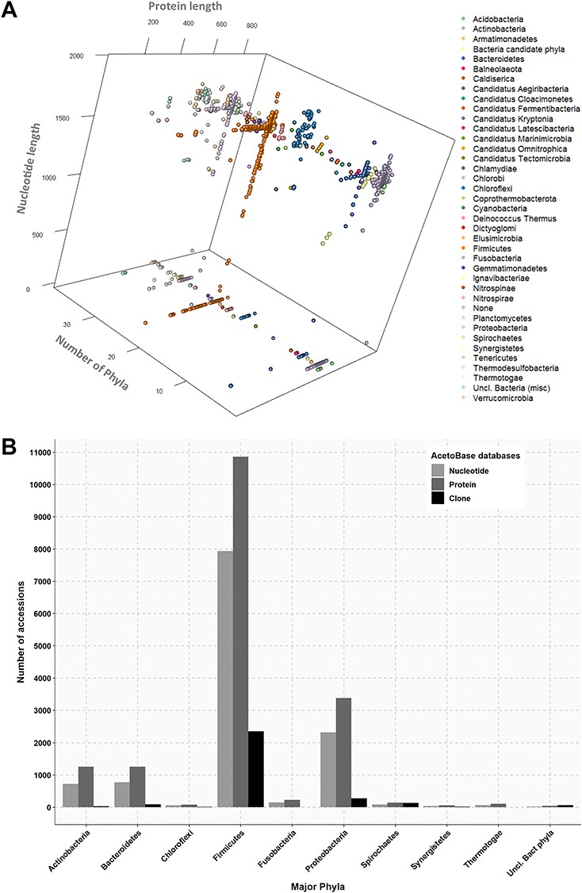
Figure 2 (A) Three-dimensional projection of nucleotide and protein sequence length according to phylum. Length of ...
Notes:
Figure 2 (A) Three-dimensional projection of nucleotide and protein sequence length according to phylum. Length of protein sequences, length of nucleotide sequences and number of phyla are shown on the x-axis, y-axis and z-axis, respectively. Protein sequences without a corresponding nucleotide sequence in the database are indicated on the z-plane. (B) Phylum affiliations of nucleotide, protein and clone accessions in AcetoBase. Phyla containing less than 20 accessions are not shown.
Unless provided in the caption above, the following copyright applies to the content of this slide: © The Author(s) 2019. Published by Oxford University Press.This is an Open Access article distributed under the terms of the Creative Commons Attribution Non-Commercial License (http://creativecommons.org/licenses/by-nc/4.0/), which permits non-commercial re-use, distribution, and reproduction in any medium, provided the original work is properly cited. For commercial re-use, please contact journals.permissions@oup.com

