Slide 1
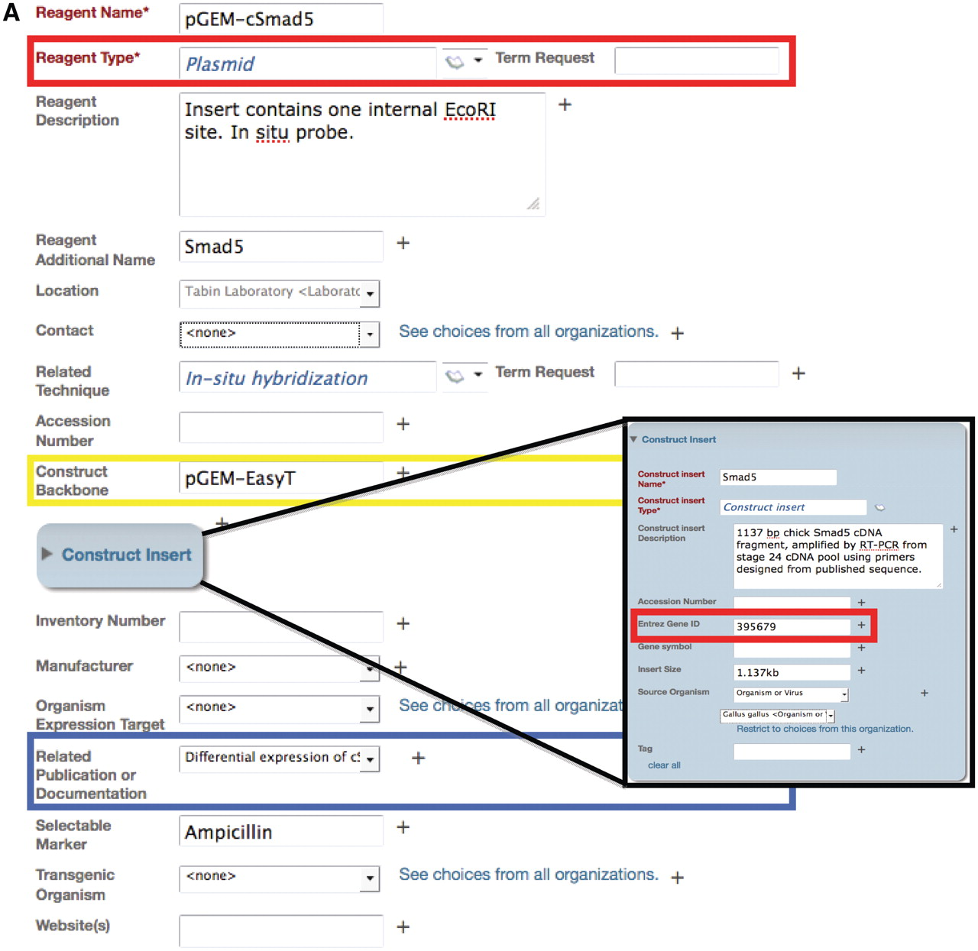
Figure 2. Example of an annotation form in the Data Collection Tool for the plasmid reagent type. (A) The Data ...
Notes:
Figure 2. Example of an annotation form in the Data Collection Tool for the plasmid reagent type. (A) The Data Collection Tool contains annotation fields that are auto-populated using the ontology (red box) and free text (yellow box). Fields in the Data Collection Tool can also link records to other records in the repository, such as related publications or documentation (blue box). Users can request new terms be added to the ontology using the Term Request field. Inset: Construct insert is an embedded class in the plasmid form and contains information that corresponds to other databases, such as Entrez Gene ID. (B) The search result upon searching for this specified plasmid. Only the fields that are filled out in the data tool are displayed in the search interface. Search results can be returned for this plasmid by searching on any of the fields that are annotated for this record. Text that is colored blue links to other records in the search interface. Hovering over the ‘i’ icons displays the ontological definition of the term, as in the example of the technique, in situ hybridization.
Unless provided in the caption above, the following copyright applies to the content of this slide: © The Author(s) 2012. Published by Oxford University Press.This is an Open Access article distributed under the terms of the Creative Commons Attribution Non-Commercial License (http://creativecommons.org/licenses/by-nc/3.0), which permits unrestricted non-commercial use, distribution, and reproduction in any medium, provided the original work is properly cited.

