Slide 1
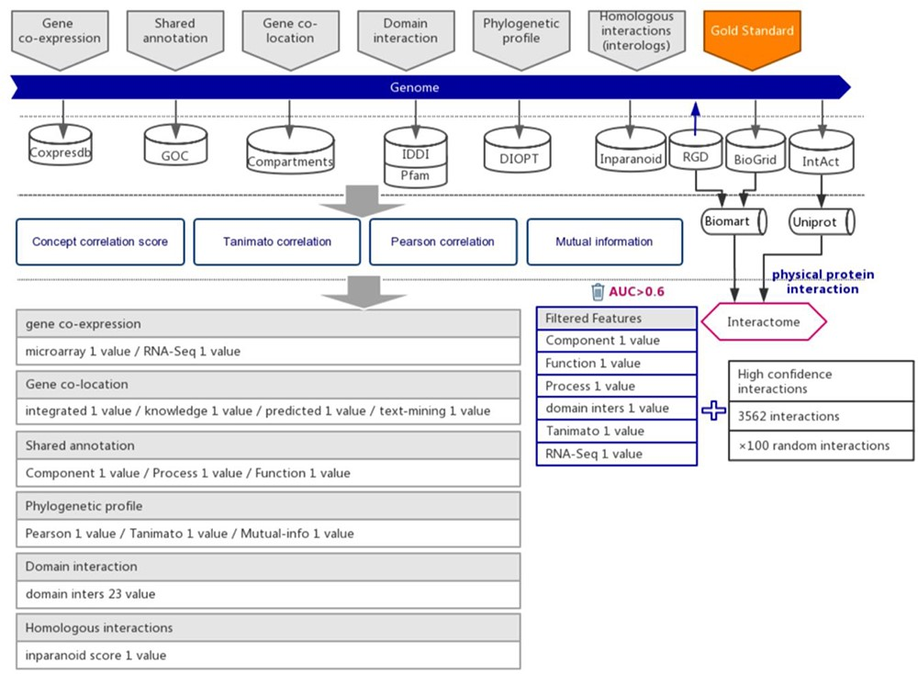
Figure 1. The workflow diagram for the influence of functional interactions between rat genes. The training dataset ...
Notes:
Figure 1. The workflow diagram for the influence of functional interactions between rat genes. The training dataset consisted of high-quality experimental confirmed protein interactions from three databases that were used as positive examples. Random gene pairs that did not overlap with positive examples were used as negative examples. The positive to negative ratio was 1:100. Six types of functional association evidence were collected from 10 databases. Six high-quality feature values were selected from 36 feature values that characterize the functional association evidence with different mathematical representations.
Unless provided in the caption above, the following copyright applies to the content of this slide: © The Author(s) 2020. Published by Oxford University Press.This is an Open Access article distributed under the terms of the Creative Commons Attribution License (http://creativecommons.org/licenses/by/4.0/), which permits unrestricted reuse, distribution, and reproduction in any medium, provided the original work is properly cited.

Slide 2
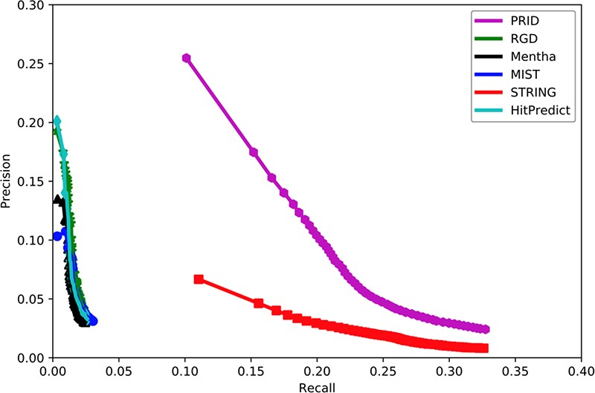
Figure 2. Assessment of six interactomes for their capabilities to group functionally related genes together. The ...
Notes:
Figure 2. Assessment of six interactomes for their capabilities to group functionally related genes together. The precision–recall curves were drawn with a series of precision and recall pairs obtained by predicting a gene’s function with its network neighbors. Precision measures the fraction of correct annotations predicted using an interactome. Recall measures the fraction of new annotations predicted using an interactome.
Unless provided in the caption above, the following copyright applies to the content of this slide: © The Author(s) 2020. Published by Oxford University Press.This is an Open Access article distributed under the terms of the Creative Commons Attribution License (http://creativecommons.org/licenses/by/4.0/), which permits unrestricted reuse, distribution, and reproduction in any medium, provided the original work is properly cited.

Slide 3
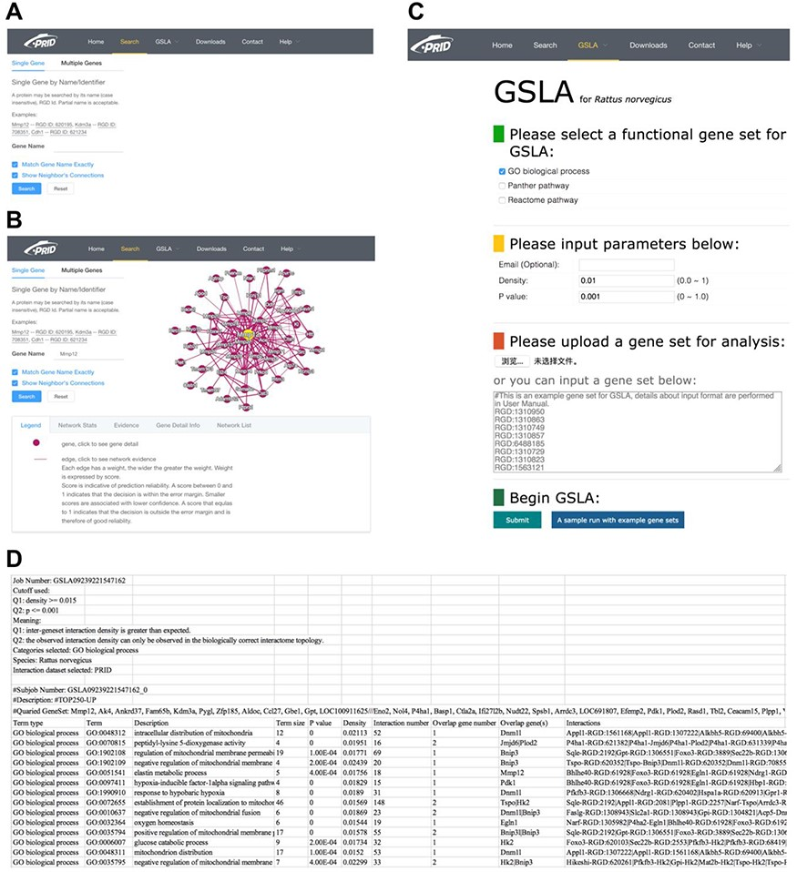
Figure 3. PRID website. (A) Single gene search and multiple gene search. (B) Search result page. Right-clicking on an ...
Notes:
Figure 3. PRID website. (A) Single gene search and multiple gene search. (B) Search result page. Right-clicking on an interaction in the diagram will show its details. (C) GSLA interface. (D) GSLA result file.
Unless provided in the caption above, the following copyright applies to the content of this slide: © The Author(s) 2020. Published by Oxford University Press.This is an Open Access article distributed under the terms of the Creative Commons Attribution License (http://creativecommons.org/licenses/by/4.0/), which permits unrestricted reuse, distribution, and reproduction in any medium, provided the original work is properly cited.

Slide 4
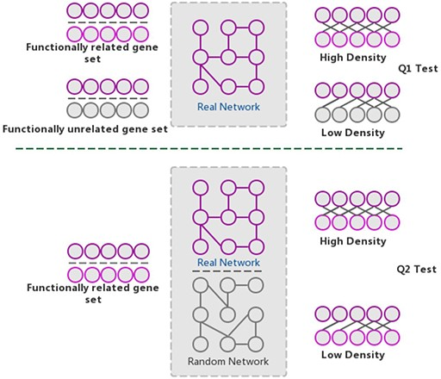
Figure 4. The GSLA algorithm. GSLA uses two hypothesis tests to identify biologically significant functional ...
Notes:
Figure 4. The GSLA algorithm. GSLA uses two hypothesis tests to identify biologically significant functional associations between gene sets. Q1 evaluates whether the intergene-set interaction density between two gene sets is higher than that between random gene pairs. Q2 evaluates whether the dense functional interactions between gene sets can only be observed within the correct network, rather than random interactomes.
Unless provided in the caption above, the following copyright applies to the content of this slide: © The Author(s) 2020. Published by Oxford University Press.This is an Open Access article distributed under the terms of the Creative Commons Attribution License (http://creativecommons.org/licenses/by/4.0/), which permits unrestricted reuse, distribution, and reproduction in any medium, provided the original work is properly cited.

Slide 5
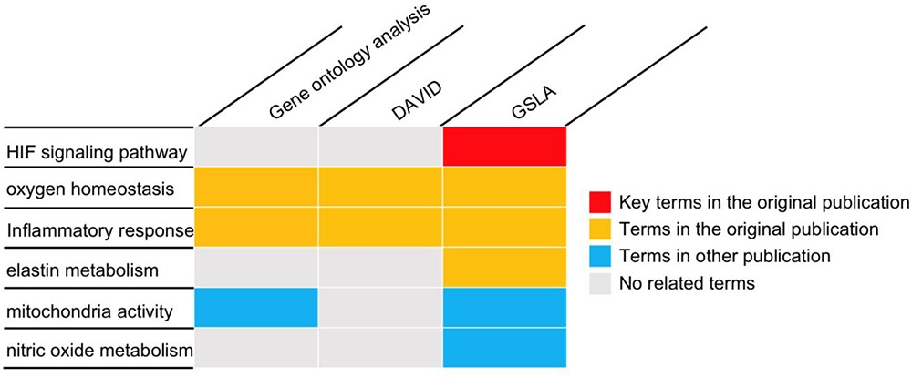
Figure 5. The gene set annotations produced by PRID/GSLA. The annotations produced by GSLA are more comprehensive and ...
Notes:
Figure 5. The gene set annotations produced by PRID/GSLA. The annotations produced by GSLA are more comprehensive and inspire further mechanism studies. We performed DAVID and gene ontology analysis for comparison.
Unless provided in the caption above, the following copyright applies to the content of this slide: © The Author(s) 2020. Published by Oxford University Press.This is an Open Access article distributed under the terms of the Creative Commons Attribution License (http://creativecommons.org/licenses/by/4.0/), which permits unrestricted reuse, distribution, and reproduction in any medium, provided the original work is properly cited.

