Slide 1
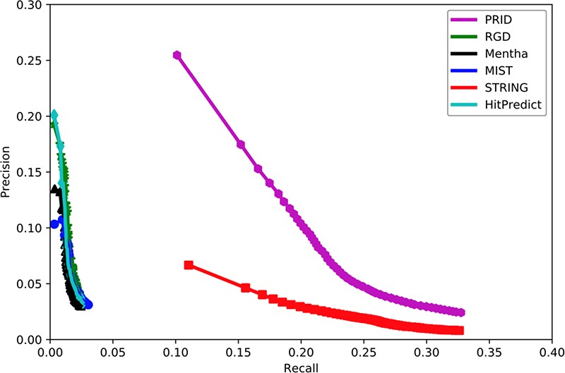
Figure 2. Assessment of six interactomes for their capabilities to group functionally related genes together. The ...
Notes:
Figure 2. Assessment of six interactomes for their capabilities to group functionally related genes together. The precision–recall curves were drawn with a series of precision and recall pairs obtained by predicting a gene’s function with its network neighbors. Precision measures the fraction of correct annotations predicted using an interactome. Recall measures the fraction of new annotations predicted using an interactome.
Unless provided in the caption above, the following copyright applies to the content of this slide: © The Author(s) 2020. Published by Oxford University Press.This is an Open Access article distributed under the terms of the Creative Commons Attribution License (http://creativecommons.org/licenses/by/4.0/), which permits unrestricted reuse, distribution, and reproduction in any medium, provided the original work is properly cited.

