Slide 1
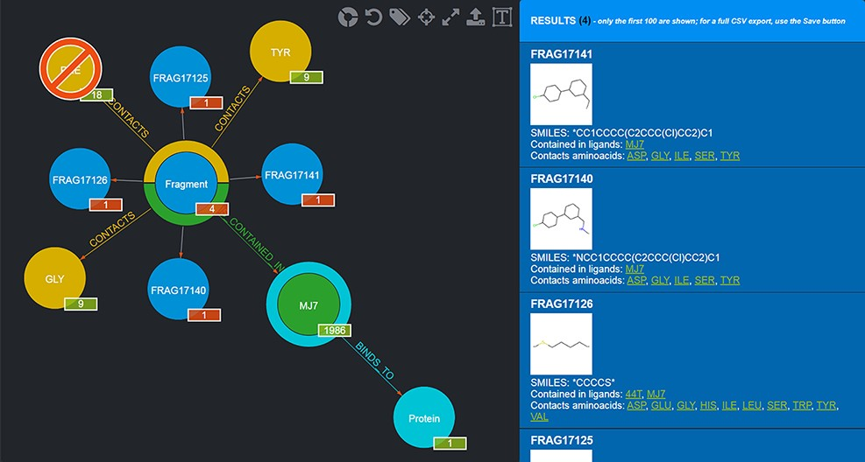
Figure 4. Example of a graphical query. The query performed shows those Fragments that contact both TYR and GLY but not ...
Notes:
Figure 4. Example of a graphical query. The query performed shows those Fragments that contact both TYR and GLY but not PHE and are contained in MJ7. This view was thus produced by filtering Fragments as follows: firstly, by clicking on the Aminoacid node and selecting TYR by clicking on it; secondly, by clicking on the yellow half-crown around the Fragment node for bringing up another ‘CONTACTS’ relationship and doing the same selection as before for GLY; thirdly, by repeating the previous step, but this time using CTRL + click to select PHE, in order to negate the relationship; fourthly, clicking on the Ligand node and selecting MJ7; finally, by clicking on the Fragment node (whose amount was reduced to 4, i.e. the only Fragments fulfilling the selected conditions) and displaying the actual Fragments resulting from the query; their details are shown in the right-side panel. The numbers on the bottom right of the nodes have the following semantics: the numbers in the red background refer to the resulting Fragments (4 total, each Fragment showing 1 as they are indeed individual); the other numbers refer to the Aminoacids they contact as a whole (9), the total number of Ligands that Fragments contacting the chosen Aminoacids are contained in (1986) and the number of proteins the selected ligand (MJ7) binds to (1).
Unless provided in the caption above, the following copyright applies to the content of this slide: © The Author(s) 2022. Published by Oxford University Press.This is an Open Access article distributed under the terms of the Creative Commons Attribution-NonCommercial License (https://creativecommons.org/licenses/by-nc/4.0/), which permits non-commercial re-use, distribution, and reproduction in any medium, provided the original work is properly cited. For commercial re-use, please contact journals.permissions@oup.com

