Slide 1
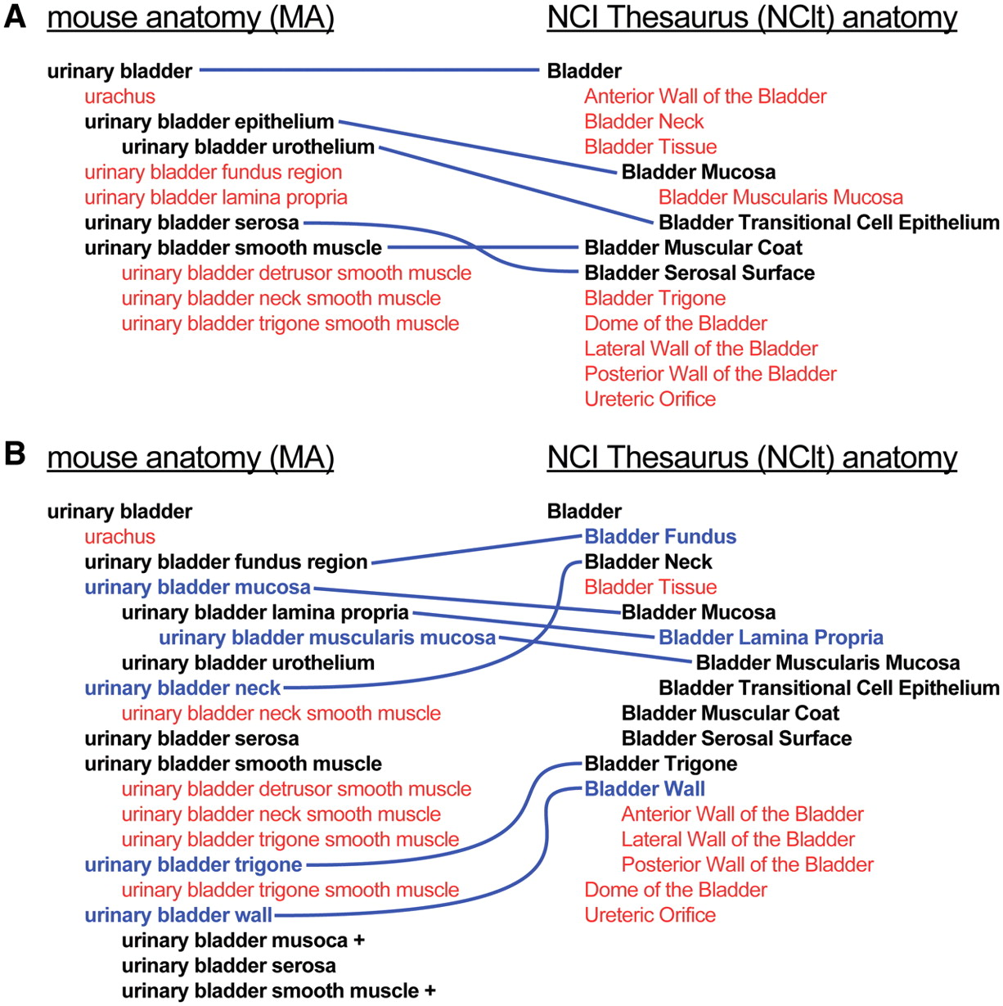
Figure 4. Example of the extension and harmonization process. (A) Representation of the urinary bladder in the MA ...
Notes:
Figure 4. Example of the extension and harmonization process. (A) Representation of the urinary bladder in the MA (left) and NCIt (right) prior to the revision process. Terms in black, linked by blue lines, represent matched sets of terms; terms in red are those not shared by the other ontology. (B) Urinary bladder concept subtrees after extension and harmonization of the ontologies. Terms in blue are those that have been added, with blue lines indicating corresponding terms in the other ontology.
Unless provided in the caption above, the following copyright applies to the content of this slide: © The Author(s) 2012. Published by Oxford University Press.This is an Open Access article distributed under the terms of the Creative Commons Attribution Non-Commercial License (http://creativecommons.org/licenses/by-nc/3.0), which permits unrestricted non-commercial use, distribution, and reproduction in any medium, provided the original work is properly cited.

