Slide 1
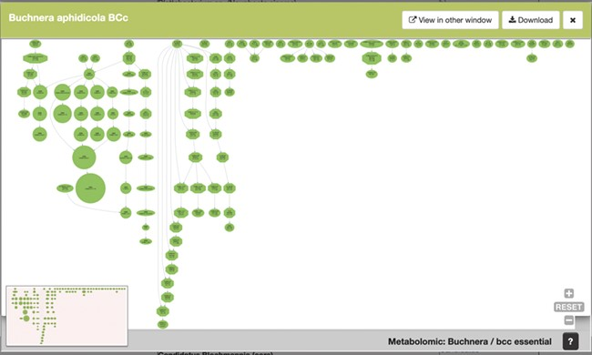
Figure 5 SymGenDB’s new MetaDAGs module’s output. In this example, we search for the symbionts of the genus ...
Notes:
Figure 5 SymGenDB’s new MetaDAGs module’s output. In this example, we search for the symbionts of the genus ‘Buchnera’. The output is a preview of a graphical display of the MetaDAG you get by choosing Buchnera aphidicola from Cinara tujafilina. This dynamic display can be viewed in another window, downloaded as a PDF and all the information of the reaction(s) included in each node(s) is available by clicking on the node(s) of interest.
Unless provided in the caption above, the following copyright applies to the content of this slide: © The Author(s) 2020. Published by Oxford University Press.This is an Open Access article distributed under the terms of the Creative Commons Attribution License (http://creativecommons.org/licenses/by/4.0/), which permits unrestricted reuse, distribution, and reproduction in any medium, provided the original work is properly cited.

