Slide 1
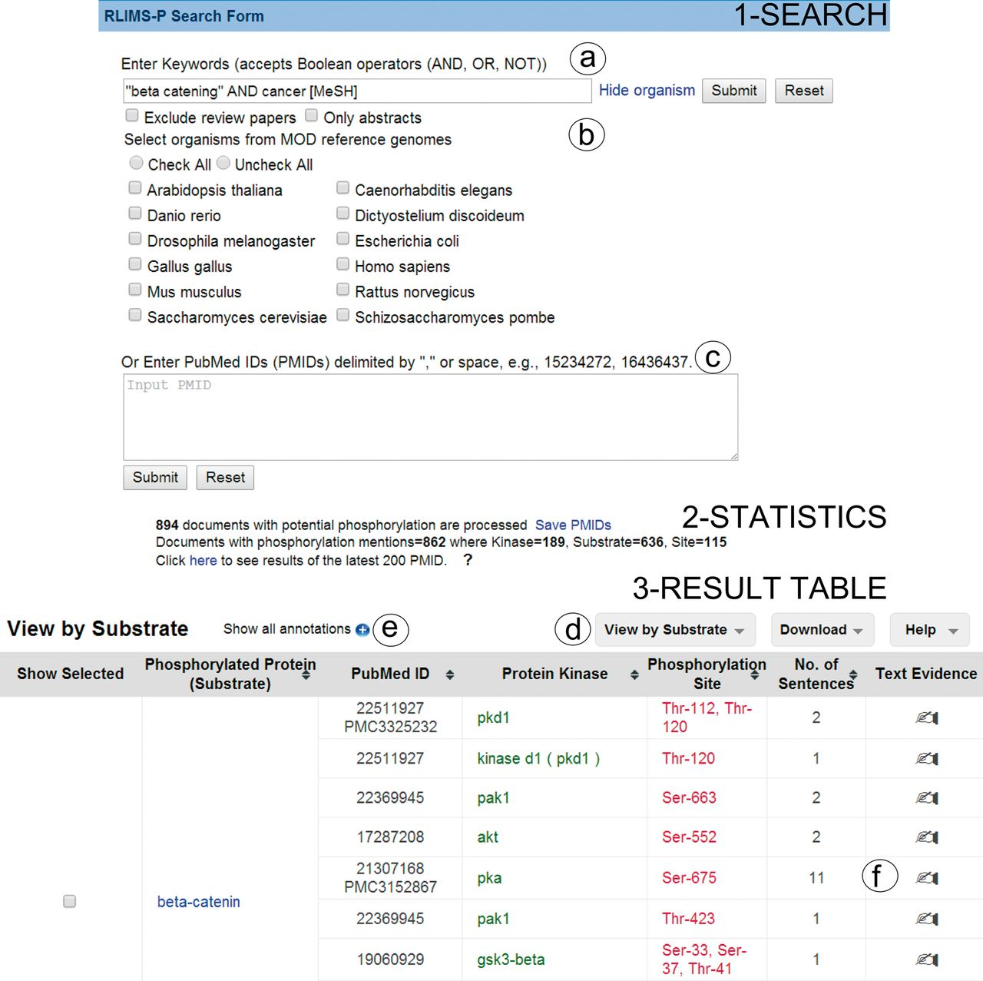
Figure 1. Snapshot of RLIMS-P interface. Search page (1-Search) and result page with statistics (2-Statistics) and ...
Notes:
Figure 1. Snapshot of RLIMS-P interface. Search page (1-Search) and result page with statistics (2-Statistics) and table (3-Result Table). The search interface allows queries based on keywords (a) with selection of species and/or abstracts only search and possibility to exclude review articles (b), or, alternatively, enter a list of PMIDs (c). The result table displays the text-mining results along with functionalities (d), such as multiple views of the result table (by PMID, by substrate or by kinase), download of table in tab-delimited format, link to help document, expansion of text-mining result by clicking on the plus icon (e) and links to text evidence page via the hand icon (f). For display convenience, the result table only shows a small subset of the full table.
Unless provided in the caption above, the following copyright applies to the content of this slide: © The Author(s) 2014. Published by Oxford University Press.This is an Open Access article distributed under the terms of the Creative Commons Attribution License (http://creativecommons.org/licenses/by/4.0/), which permits unrestricted reuse, distribution, and reproduction in any medium, provided the original work is properly cited.

Slide 2
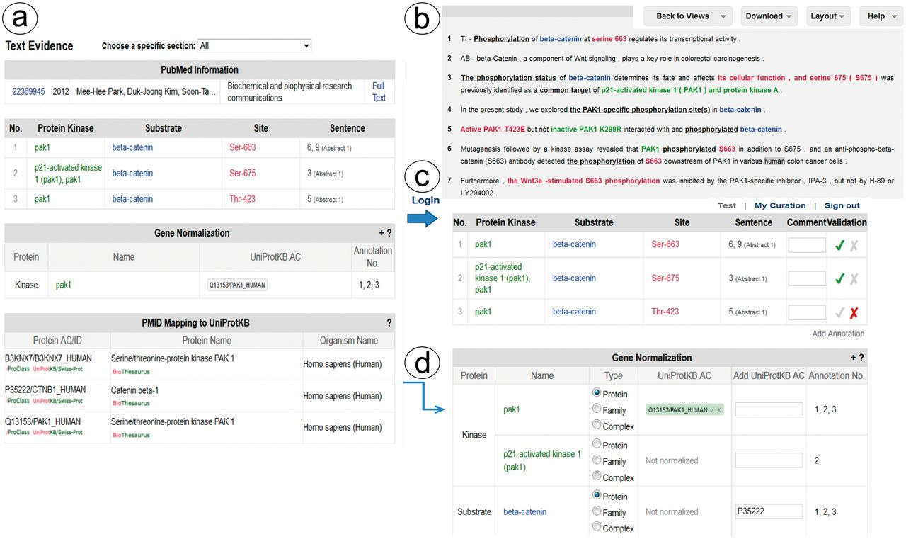
Figure 2. Snapshot of RLIMS-P text evidence page. The text evidence page contains two panels, one containing tables for ...
Notes:
Figure 2. Snapshot of RLIMS-P text evidence page. The text evidence page contains two panels, one containing tables for the article general information, the RLIMS-P annotation, the normalization and UniProtKB mapping (a); the other containing the text with color-coded entities (b). Once the user logs in, new boxes for editing and validating the annotation and normalization appear (c). The information in the mapping table can be used to assist in normalization task during curation (d).
Unless provided in the caption above, the following copyright applies to the content of this slide: © The Author(s) 2014. Published by Oxford University Press.This is an Open Access article distributed under the terms of the Creative Commons Attribution License (http://creativecommons.org/licenses/by/4.0/), which permits unrestricted reuse, distribution, and reproduction in any medium, provided the original work is properly cited.

