Slide 1
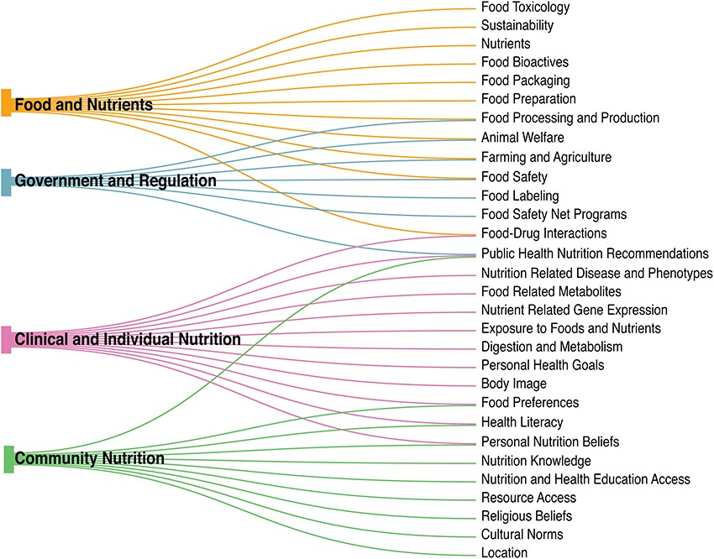
Figure 1. The nutri-informatics landscape. Nutrition is complex and heterogeneous in nature, ranging from larger ...
Notes:
Figure 1. The nutri-informatics landscape. Nutrition is complex and heterogeneous in nature, ranging from larger categories of ‘Food and Nutrients’ to ‘Government and Regulation’, yet within each broad category, many subcategories are shared.
Unless provided in the caption above, the following copyright applies to the content of this slide: © The Author(s) 2021. Published by Oxford University Press.This is an Open Access article distributed under the terms of the Creative Commons Attribution License (http://creativecommons.org/licenses/by/4.0/), which permits unrestricted reuse, distribution, and reproduction in any medium, provided the original work is properly cited.

Slide 2
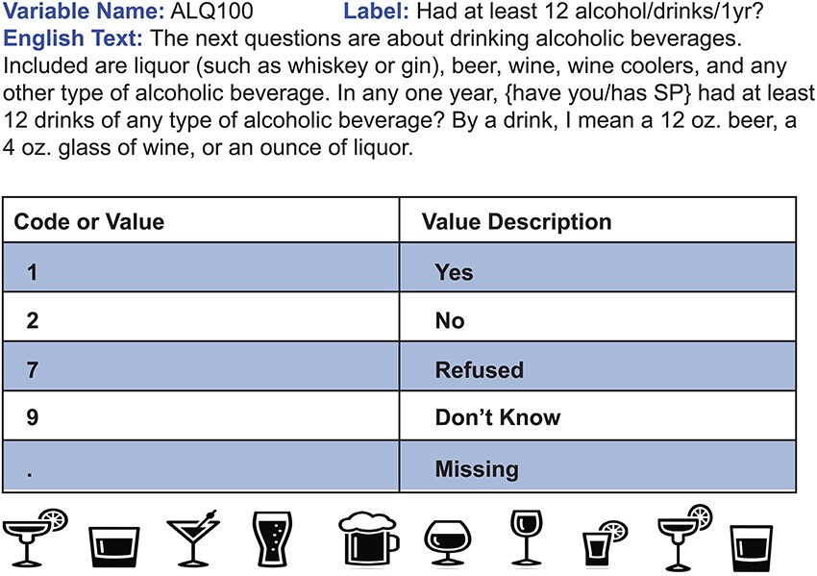
Figure 2. Sample CDE. This question is an example of a CDE from the NHANES 1999–2000 questionnaire. In this instance, ...
Notes:
Figure 2. Sample CDE. This question is an example of a CDE from the NHANES 1999–2000 questionnaire. In this instance, survey participants were inquired about alcohol consumption throughout the year and their responses were standardized using the corresponding code/value pair. Usage of this CDE in a separate survey, such as a future year of NHANES, will allow data from both surveys to be directly comparable.
Unless provided in the caption above, the following copyright applies to the content of this slide: © The Author(s) 2021. Published by Oxford University Press.This is an Open Access article distributed under the terms of the Creative Commons Attribution License (http://creativecommons.org/licenses/by/4.0/), which permits unrestricted reuse, distribution, and reproduction in any medium, provided the original work is properly cited.

Slide 3
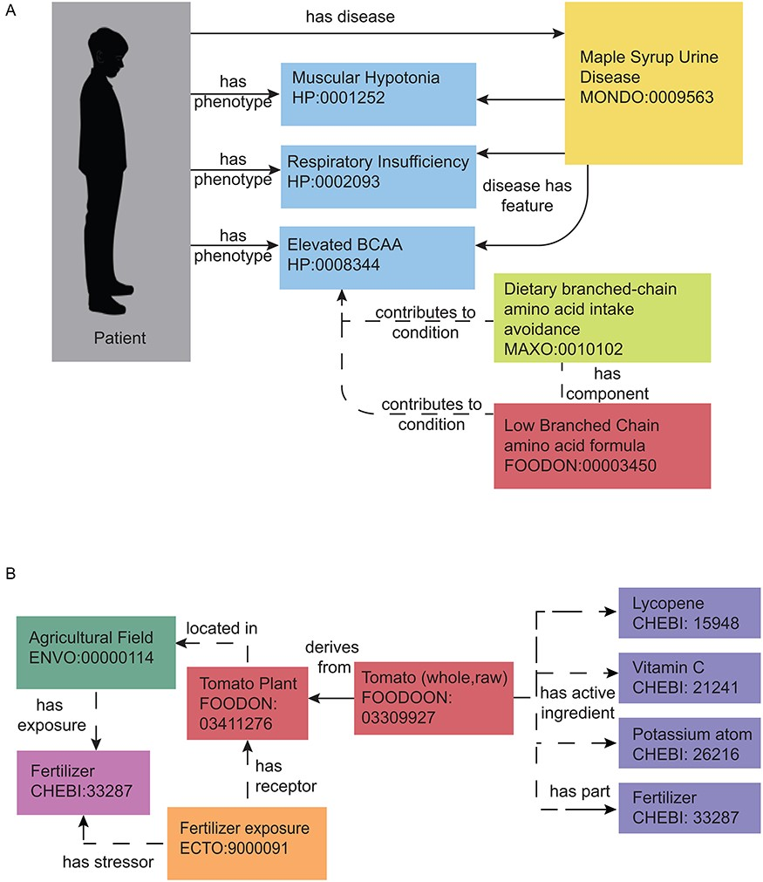
Figure 3. Representing nutrition using ontologies. Nutrition representation in current ontologies and databases is not ...
Notes:
Figure 3. Representing nutrition using ontologies. Nutrition representation in current ontologies and databases is not yet sufficient to meet the needs of the nutri-informatics research community, yet some meaningful relationships can still be identified within the current landscape. Currently defined relationships can be seen with solid arrows and proposed modeling relationships can be seen in dashed arrows. (A) MSUD. This rare metabolic disease can be annotated with related phenotypes, nutritional recommendations and medical foods using interoperable biomedical ontology terms. These present and proposed relationships can be used to facilitate disease and therapeutic intervention identification with a set of patient phenotypes. (B) Farm to Fork with a Tomato. The process of growing a tomato can also be annotated by its exposures and nutrient content. Present and proposed relationships can connect fertilizer application at the field, to the food produced, to its nutrient and potential chemical content.
Unless provided in the caption above, the following copyright applies to the content of this slide: © The Author(s) 2021. Published by Oxford University Press.This is an Open Access article distributed under the terms of the Creative Commons Attribution License (http://creativecommons.org/licenses/by/4.0/), which permits unrestricted reuse, distribution, and reproduction in any medium, provided the original work is properly cited.

Slide 4
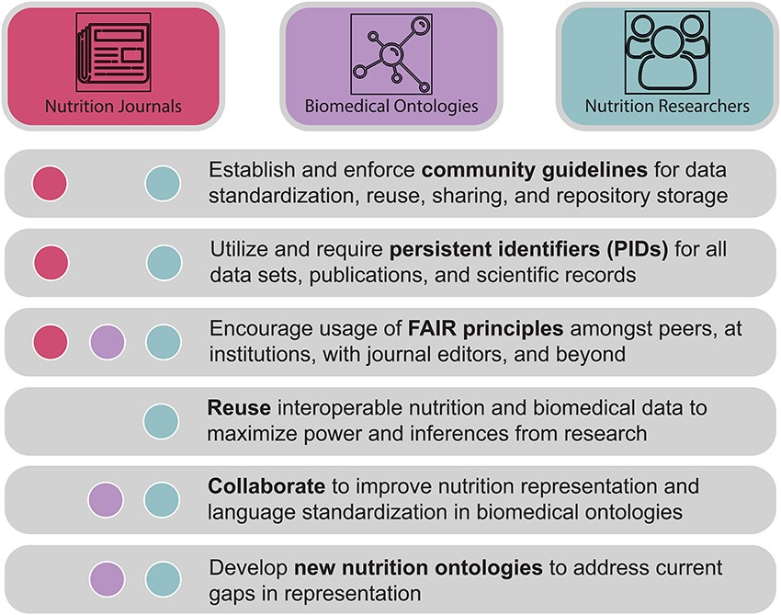
Figure 4. A call to action. Nutri-informatics stakeholders such as nutrition researchers, biomedical ontology ...
Notes:
Figure 4. A call to action. Nutri-informatics stakeholders such as nutrition researchers, biomedical ontology developers and academic journal communities are needed to realize the connectivity and analyzability of nutrition data. Key tasks are described here, including actions to improve data interoperability, identifiability and collaboration between communities.
Unless provided in the caption above, the following copyright applies to the content of this slide: © The Author(s) 2021. Published by Oxford University Press.This is an Open Access article distributed under the terms of the Creative Commons Attribution License (http://creativecommons.org/licenses/by/4.0/), which permits unrestricted reuse, distribution, and reproduction in any medium, provided the original work is properly cited.

