Slide 1
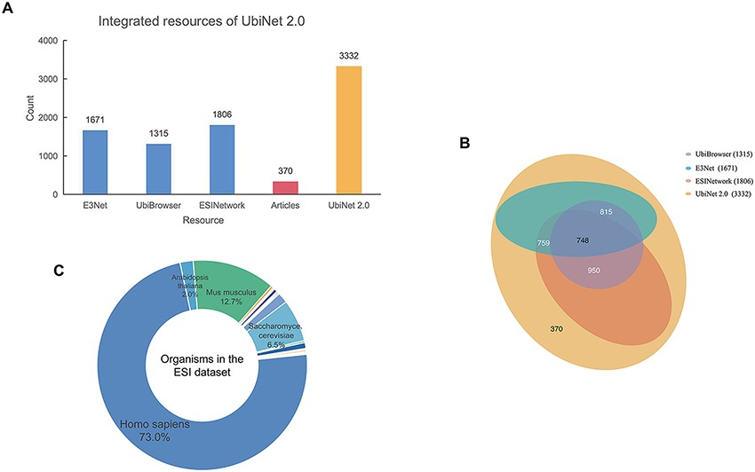
Figure 2. Integrated resources of UbiNet 2.0. (A) The numbers of ESIs collected from three other platforms, literature ...
Notes:
Figure 2. Integrated resources of UbiNet 2.0. (A) The numbers of ESIs collected from three other platforms, literature as well as UbiNet 2.0. (B) The Venn diagram on the resources. It shows the overlap of ESI records between the resources. The numbers in the brackets beside the database names are the total number of ESIs in the corresponding database. (C) Organisms involved in the ESI data set of UbiNet 2.0.
Unless provided in the caption above, the following copyright applies to the content of this slide: © The Author(s) 2021. Published by Oxford University Press.This is an Open Access article distributed under the terms of the Creative Commons Attribution License (http://creativecommons.org/licenses/by/4.0/), which permits unrestricted reuse, distribution, and reproduction in any medium, provided the original work is properly cited.

