Slide 1
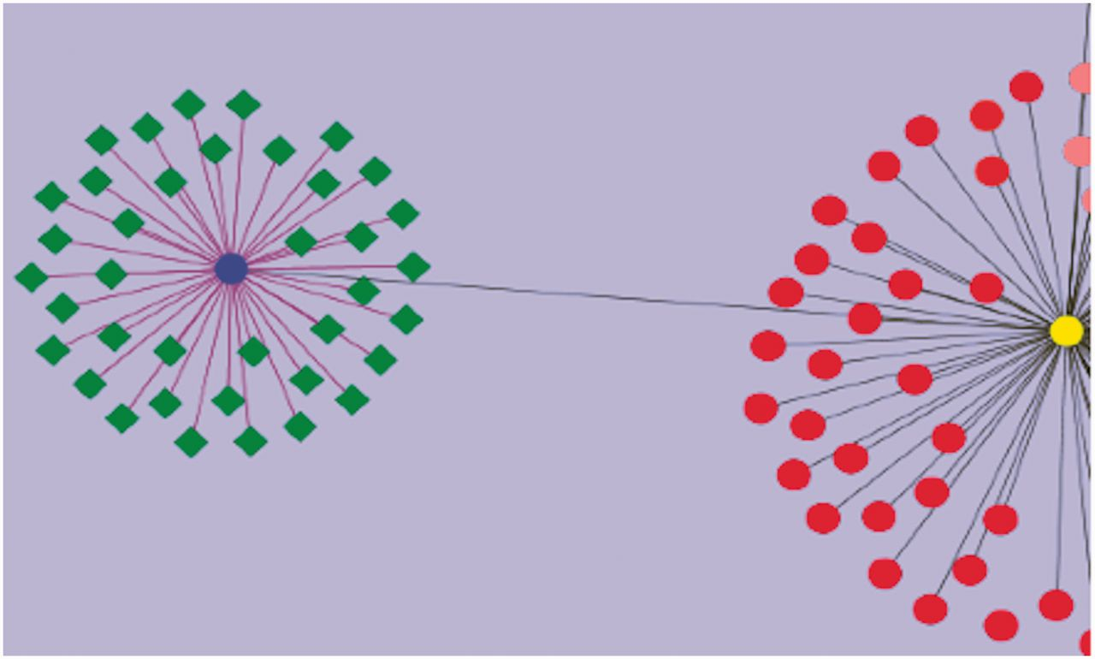
Figure 4. Visualization of genes associated with drought tolerance in Solanaceae. A simple example network is shown. ...
Notes:
Figure 4. Visualization of genes associated with drought tolerance in Solanaceae. A simple example network is shown. The nodes represent genes, and the edges represent relationships between the genes. The blue circular node is WRKY 39 and the green nodes having diamond shapes are genes associated with drought, annotated in the SGN database. The purple edges connecting WRKY 39 to the other genes represent the relationship based on the evidence code ‘Co-expressed’. These genes have been curated from an article reporting a transcriptomic study of drought response genes in tomato species. The deep gray colored edge connects WRKY 39 transcription factor to WRKY 1 (yellow circular node) in a paralogous relationship. Similarly all red colored nodes are the WRKY gene family members curated in SGN. This network diagram shows the genes in the SGN database that have been currently annotated to the GO term, ‘GO: response to water deprivation’.
Unless provided in the caption above, the following copyright applies to the content of this slide: © The Author(s) 2013. Published by Oxford University Press.This is an Open Access article distributed under the terms of the Creative Commons Attribution Non-Commercial License (http://creativecommons.org/licenses/by-nc/3.0/), which permits unrestricted non-commercial use, distribution, and reproduction in any medium, provided the original work is properly cited.

