Slide 1
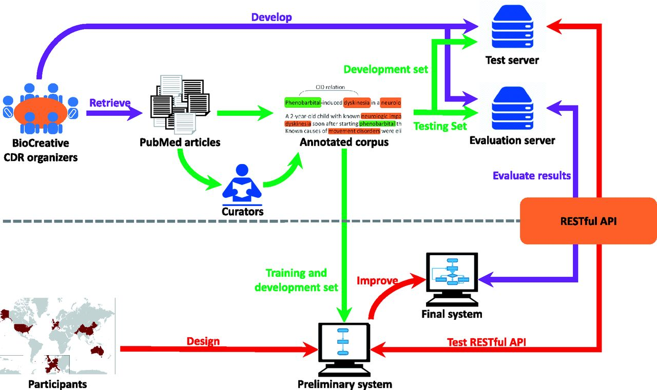
Figure 1. The pipeline of the task workflow. The task organization is shown in purple; corpus development is shown in ...
Notes:
Figure 1. The pipeline of the task workflow. The task organization is shown in purple; corpus development is shown in green; and team participation is shown in red.
Unless provided in the caption above, the following copyright applies to the content of this slide: Published by Oxford University Press 2016. This work is written by US Government employees and is in the public domain in the US.

