Slide 1
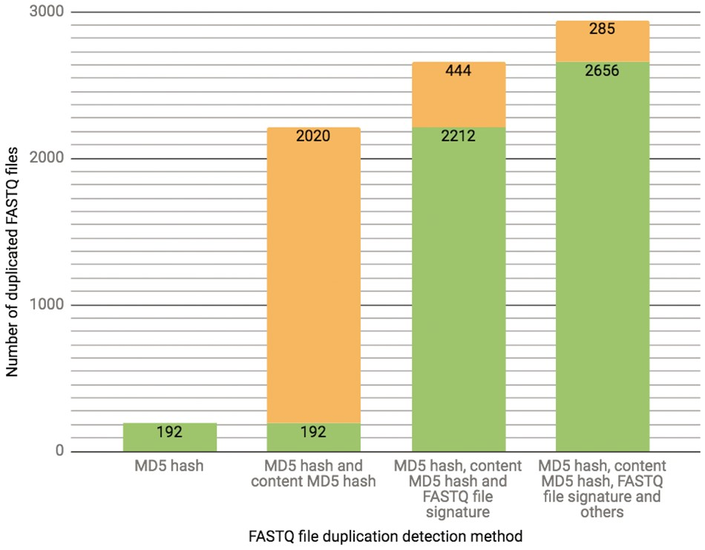
Figure 3. The chart presents the breakdown of the total number (2941 as of 10/13/2017) of FASTQ file duplication events ...
Notes:
Figure 3. The chart presents the breakdown of the total number (2941 as of 10/13/2017) of FASTQ file duplication events detected in our database using different methods. Each successive bar shows the split between the number of files that could be detected with the methods from the previous bar (depicted in a green color) as well as those that could only be detected with the additional method (depicted in an orange color). The final 285 FASTQ files were considered duplicates based on manual curation.
Unless provided in the caption above, the following copyright applies to the content of this slide: © The Author(s) 2018. Published by Oxford University Press.This is an Open Access article distributed under the terms of the Creative Commons Attribution License (http://creativecommons.org/licenses/by/4.0/), which permits unrestricted reuse, distribution, and reproduction in any medium, provided the original work is properly cited.

