Slide 1
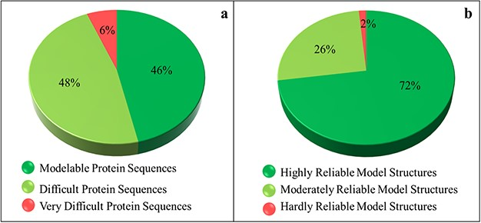
Figure 3 Sequence- and structure-based quantification of soluble proteome of PvP01 strain of P. vivax. (a) SDI-based ...
Notes:
Figure 3 Sequence- and structure-based quantification of soluble proteome of PvP01 strain of P. vivax. (a) SDI-based characterization into Modelable, Difficult and Very Difficult regions of structural modelability. (b) Structure quality assessment of soluble proteome of PvP01 into highly reliable and hardly reliable regions of structural quality.
Unless provided in the caption above, the following copyright applies to the content of this slide: © The Author(s) 2020. Published by Oxford University Press.This is an Open Access article distributed under the terms of the Creative Commons Attribution License (http://creativecommons.org/licenses/by/4.0/), which permits unrestricted reuse, distribution, and reproduction in any medium, provided the original work is properly cited.

