Slide 1
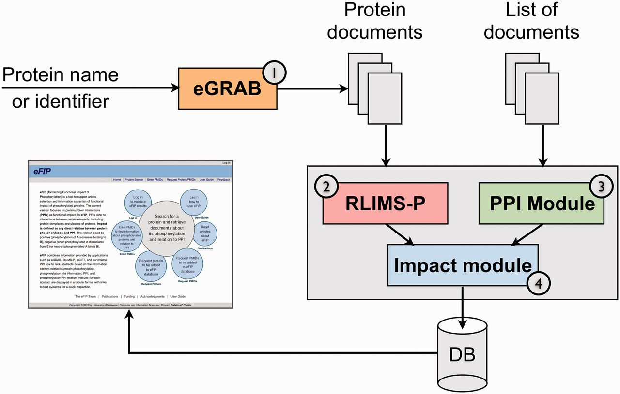
Figure 1 The eFIP text mining system overview. The pipeline consists of four components to process: (1) retrieval of ...
Notes:
Figure 1 The eFIP text mining system overview. The pipeline consists of four components to process: (1) retrieval of all documents relevant to a given protein (eGRAB), (2) extraction of phosphorylation mentions (kinase, substrate and site) in these documents (RLIMS-P), (3) extraction of PPI mentions (protein interactants and type of interaction) (PPI module) and (4) detection of phosphorylation-interaction relations (impact module).
Unless provided in the caption above, the following copyright applies to the content of this slide: © The Author(s) 2012. Published by Oxford University Press.This is an Open Access article distributed under the terms of the Creative Commons Attribution License (http://creativecommons.org/licenses/by-nc/3.0/), which permits non-commercial reuse, distribution, and reproduction in any medium, provided the original work is properly cited. For commercial re-use, please contact journals.permissions@oup.com.

