Slide 1
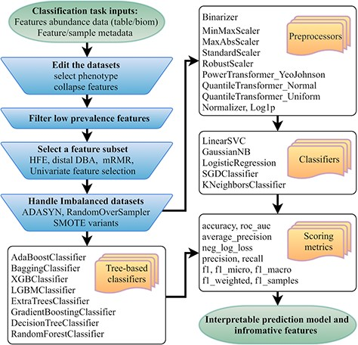
Figure 1 Flowchart of the mAML pipeline. At least two files indicated at the beginning of the pipeline should be ...
Notes:
Figure 1 Flowchart of the mAML pipeline. At least two files indicated at the beginning of the pipeline should be provided. Operation steps before training are indicated in the blue inverse-trapezoids.
Unless provided in the caption above, the following copyright applies to the content of this slide: © The Author(s) 2020. Published by Oxford University Press.This is an Open Access article distributed under the terms of the Creative Commons Attribution License (http://creativecommons.org/licenses/by/4.0/), which permits unrestricted reuse, distribution, and reproduction in any medium, provided the original work is properly cited.

Slide 2
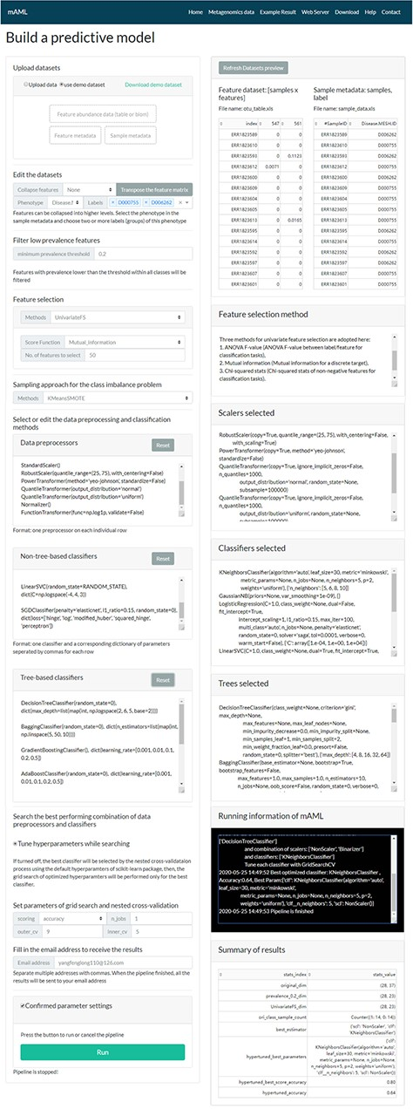
Figure 2 The task submission page of the mAML server. The left column displays the settings for each step, and the ...
Notes:
Figure 2 The task submission page of the mAML server. The left column displays the settings for each step, and the right column shows the real-time feedback of the parameter settings.
Unless provided in the caption above, the following copyright applies to the content of this slide: © The Author(s) 2020. Published by Oxford University Press.This is an Open Access article distributed under the terms of the Creative Commons Attribution License (http://creativecommons.org/licenses/by/4.0/), which permits unrestricted reuse, distribution, and reproduction in any medium, provided the original work is properly cited.

Slide 3
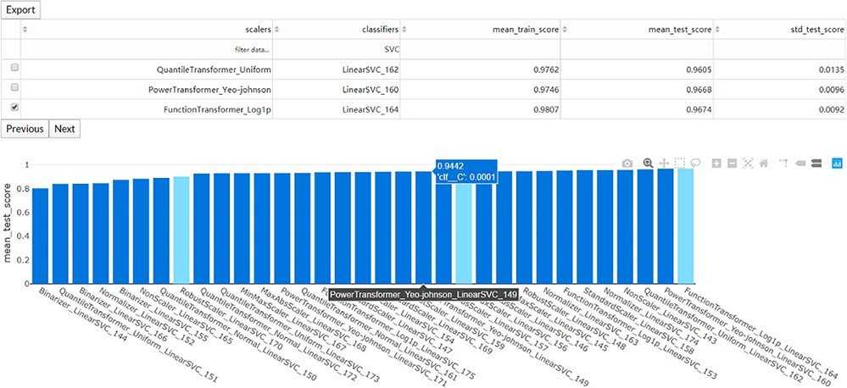
Figure 3 The interaction diagram for the performance of all the candidate models. The users can screen the candidate ...
Notes:
Figure 3 The interaction diagram for the performance of all the candidate models. The users can screen the candidate models by the scalers, classifiers, mean training score, mean test score and standard test score.
Unless provided in the caption above, the following copyright applies to the content of this slide: © The Author(s) 2020. Published by Oxford University Press.This is an Open Access article distributed under the terms of the Creative Commons Attribution License (http://creativecommons.org/licenses/by/4.0/), which permits unrestricted reuse, distribution, and reproduction in any medium, provided the original work is properly cited.

Slide 4
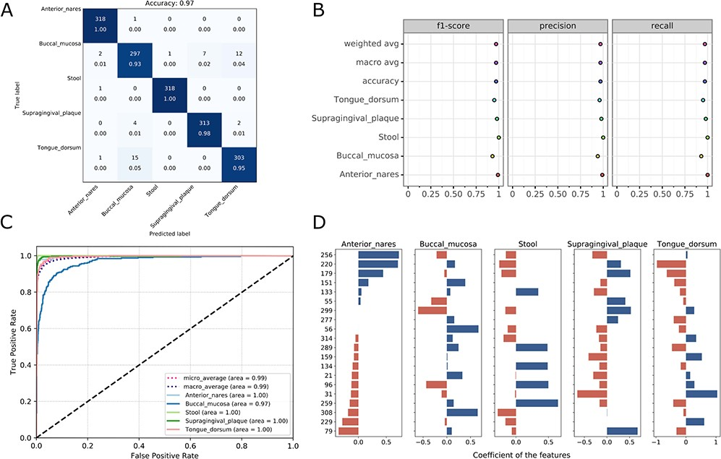
Figure 4 Visualizations for the optimized model: the heatmap for confusing matrix (A), the classification report (B), ...
Notes:
Figure 4 Visualizations for the optimized model: the heatmap for confusing matrix (A), the classification report (B), ROC curve (C) and the histogram for top features (D, default: 20). Note that, in the case of tree-based models, the feature importance will be provided instead of the feature’s coefficient in the histogram.
Unless provided in the caption above, the following copyright applies to the content of this slide: © The Author(s) 2020. Published by Oxford University Press.This is an Open Access article distributed under the terms of the Creative Commons Attribution License (http://creativecommons.org/licenses/by/4.0/), which permits unrestricted reuse, distribution, and reproduction in any medium, provided the original work is properly cited.

Slide 5
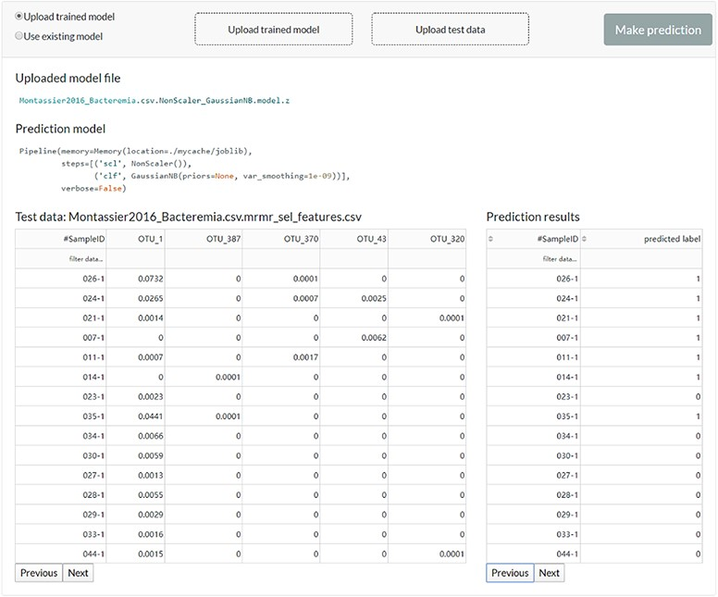
Figure 5 The web server interface for the users to reuse the existing model or upload a previously trained model to ...
Notes:
Figure 5 The web server interface for the users to reuse the existing model or upload a previously trained model to make predictions.
Unless provided in the caption above, the following copyright applies to the content of this slide: © The Author(s) 2020. Published by Oxford University Press.This is an Open Access article distributed under the terms of the Creative Commons Attribution License (http://creativecommons.org/licenses/by/4.0/), which permits unrestricted reuse, distribution, and reproduction in any medium, provided the original work is properly cited.

Slide 6
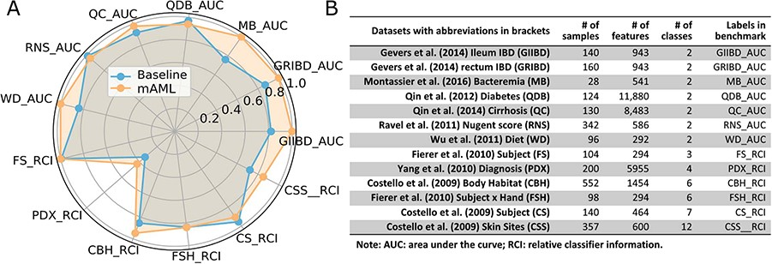
Figure 6 The performance comparison of the mAML proposed models against the baseline (A). The labels are connected ...
Notes:
Figure 6 The performance comparison of the mAML proposed models against the baseline (A). The labels are connected abbreviations with an underline between the name of the database and the metric used in the original study (B).
Unless provided in the caption above, the following copyright applies to the content of this slide: © The Author(s) 2020. Published by Oxford University Press.This is an Open Access article distributed under the terms of the Creative Commons Attribution License (http://creativecommons.org/licenses/by/4.0/), which permits unrestricted reuse, distribution, and reproduction in any medium, provided the original work is properly cited.

Slide 7
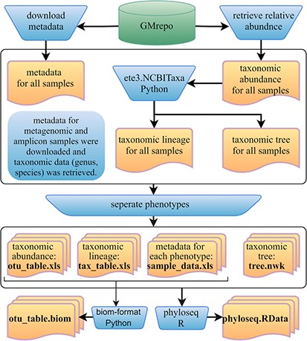
Figure 7 Framework of the GMrepo ML repository construction. Operation steps are indicated in the blue ...
Notes:
Figure 7 Framework of the GMrepo ML repository construction. Operation steps are indicated in the blue inverse-trapezoids. Files with names in bold are all contained in the repository, and they can be retrieved from the ‘Metagenomics data’ page of the server or from the GitHub.
Unless provided in the caption above, the following copyright applies to the content of this slide: © The Author(s) 2020. Published by Oxford University Press.This is an Open Access article distributed under the terms of the Creative Commons Attribution License (http://creativecommons.org/licenses/by/4.0/), which permits unrestricted reuse, distribution, and reproduction in any medium, provided the original work is properly cited.

