Slide 1
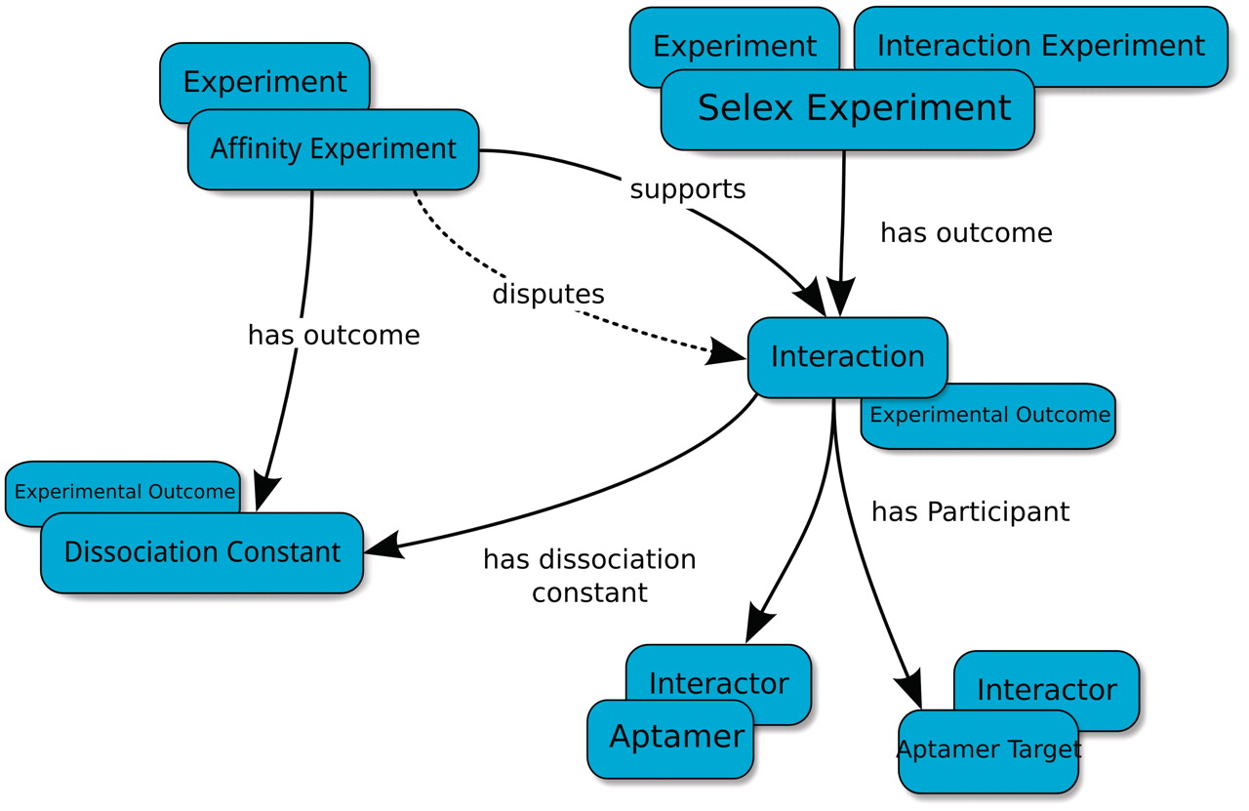
Figure 1. Basic type-relation map used by the Aptamer Base to describe SELEX experiments. The Interaction Experiment ...
Notes:
Figure 1. Basic type-relation map used by the Aptamer Base to describe SELEX experiments. The Interaction Experiment type ‘has outcome’ an Interaction. Each Interaction ‘has participant’ at least two Interactors (Aptamer and Aptamer Target). The Affinity Experiment type ‘has outcome’ a Dissociation Constant that either ‘confirms’ or ‘disputes’ an interaction. Blue ellipses denote types and arrows represent properties between topics. Overlapping ellipses represent the multiple types associated with a topic. For more details visit http://aptamerbase.semanticscience.org/?q=node/1.
Unless provided in the caption above, the following copyright applies to the content of this slide: © The Author(s) 2012. Published by Oxford University Press.This is an Open Access article distributed under the terms of the Creative Commons Attribution Non-Commercial License (http://creativecommons.org/licenses/by-nc/3.0), which permits unrestricted non-commercial use, distribution, and reproduction in any medium, provided the original work is properly cited.

