Slide 1
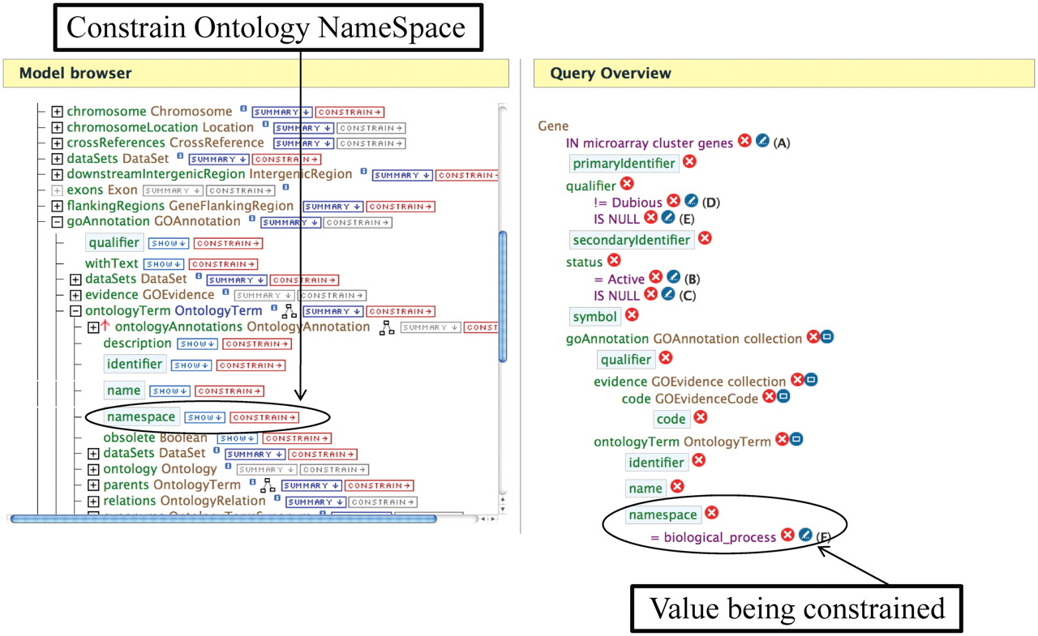
Figure 2. An example of editing a template using the Query Builder. The Model Browser (on the left) displays the ...
Notes:
Figure 2. An example of editing a template using the Query Builder. The Model Browser (on the left) displays the attributes for the GOAnnotation object in the Gene→GO Terms template. Clicking on the ‘CONSTRAIN→’ button next to the namespace box allows one to constrain on the ontology namespace. The Query Overview (on the right) shows the ontology namespace being restricted to the value ‘Biological Process’.
Unless provided in the caption above, the following copyright applies to the content of this slide: © The Author(s) 2012. Published by Oxford University Press.This is an Open Access article distributed under the terms of the Creative Commons Attribution Non-Commercial License (http://creativecommons.org/licenses/by-nc/3.0), which permits unrestricted non-commercial use, distribution, and reproduction in any medium, provided the original work is properly cited.

