Slide 1
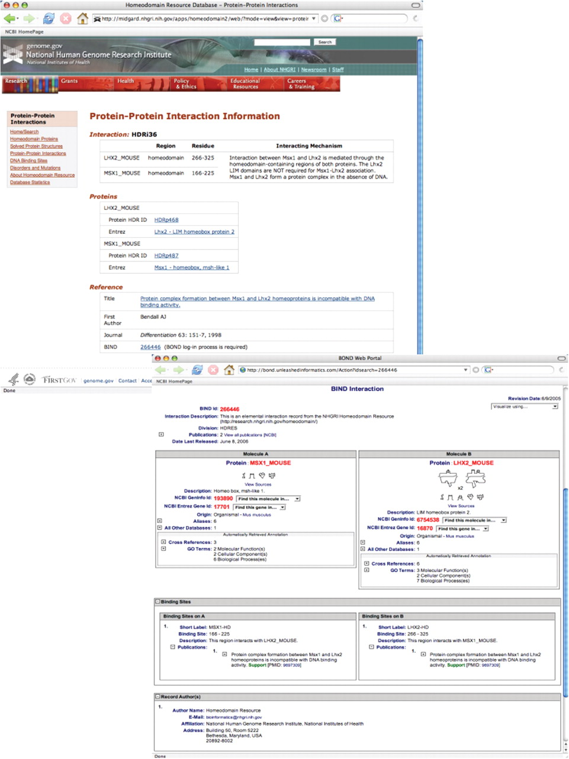
Figure 3. Search results from a query of protein–protein interactions data for the interaction of homeodomain proteins ...
Notes:
Figure 3. Search results from a query of protein–protein interactions data for the interaction of homeodomain proteins Lhx2 and Msx1 (SEARCH ‘Protein-Protein Interactions’ FOR ‘MSX1’) (top). Each protein–protein interaction entry within the Homeodomain Resource is hyperlinked to the corresponding entry in BIND, which provides additional details on the mechanism(s) of interaction (bottom). See text for additional details.
Unless provided in the caption above, the following copyright applies to the content of this slide: Published by Oxford University Press 2009.This is Open Access article distributed under the terms of the Creative Commons Attribution Non-Commercial License (http://creativecommons.org/licenses/by-nc/2.0/uk/) which permits unrestricted non-commercial use, distribution, and reproduction in any medium, provided the original work is properly cited.

