Slide 1
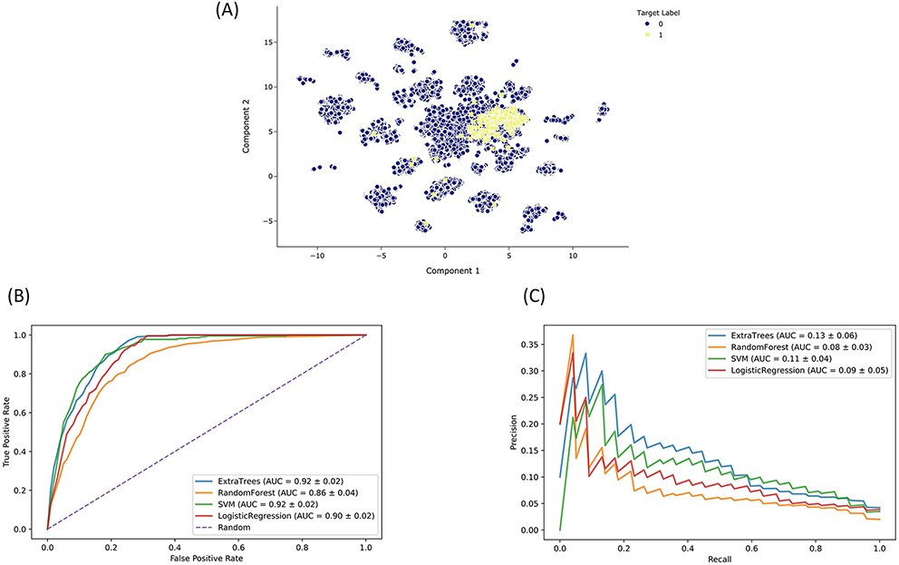
Figure 5. Drugmonizome-ML classifier for prioritizing drugs that may induce peripheral neuropathy. (A) Input feature ...
Notes:
Figure 5. Drugmonizome-ML classifier for prioritizing drugs that may induce peripheral neuropathy. (A) Input feature space with Uniform Manifold Approximation and Projection (UMAP) dimensionality reduction. Each point represents one of 19 898 compounds with 3026 features per compound. Compounds with the known side effect of peripheral neuropathy are highlighted in yellow. (B) ROC and (C) PRC across cross-validation splits after hyperparameter optimization for each classifier to predict peripheral neuropathy. Each curve shows the mean ROC and standard deviation after 10-fold cross-validation for each classifier.
Unless provided in the caption above, the following copyright applies to the content of this slide: © The Author(s) 2021. Published by Oxford University Press.This is an Open Access article distributed under the terms of the Creative Commons Attribution License (http://creativecommons.org/licenses/by/4.0/), which permits unrestricted reuse, distribution, and reproduction in any medium, provided the original work is properly cited.

