Slide 1
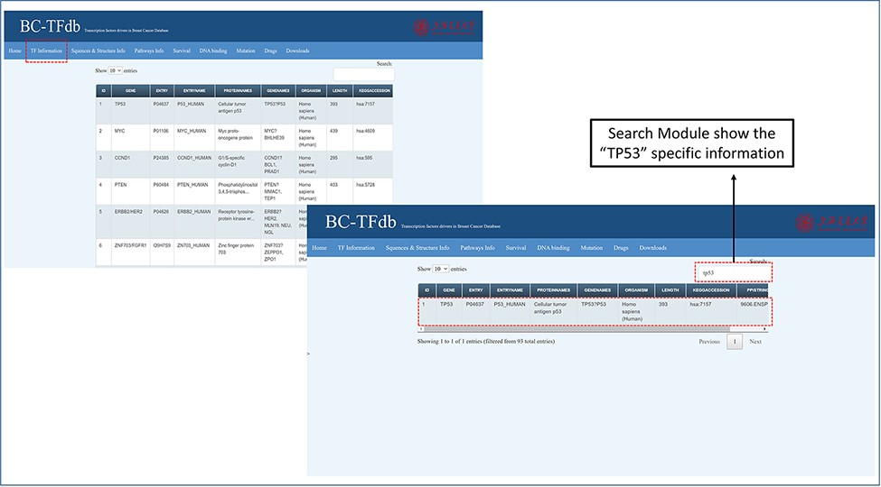
Figure 2. Representative image of the basic information tab showing details about TFs from the dataset of the cohort ...
Notes:
Figure 2. Representative image of the basic information tab showing details about TFs from the dataset of the cohort study. The bottom panel shows the search module implemented in the database to obtain specific information.
Unless provided in the caption above, the following copyright applies to the content of this slide: © Crown copyright 2021.This Open Access article contains public sector information licensed under the Open Government Licence v3.0 (http://www.nationalarchives.gov.uk/doc/open-government-licence/version/3/).

