Slide 1
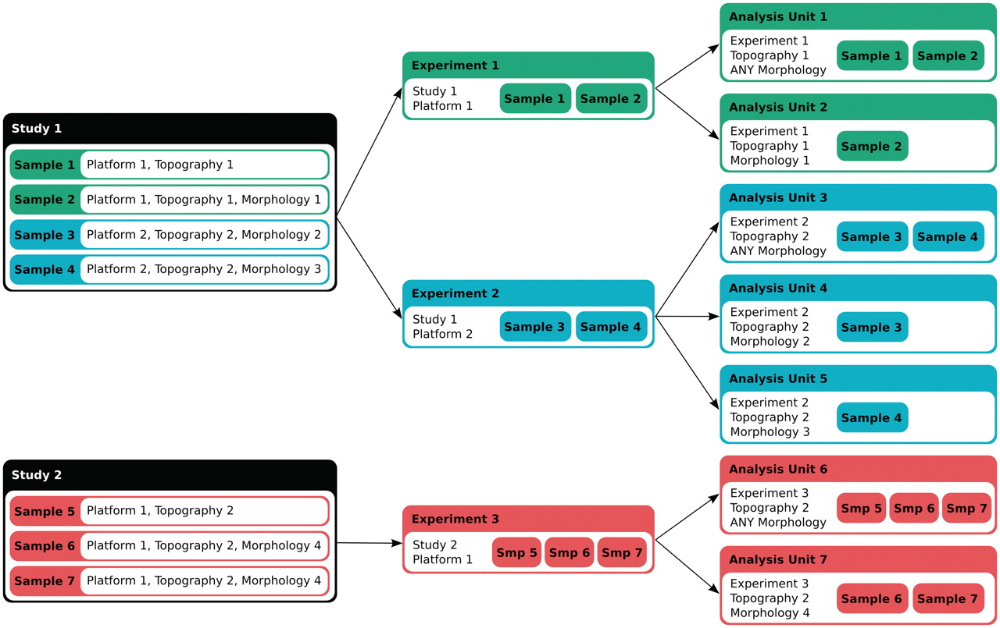
Figure 1. Data annotation and classification. Each sample assay in a study is annotated for the platform and the ICD-O ...
Notes:
Figure 1. Data annotation and classification. Each sample assay in a study is annotated for the platform and the ICD-O topography and morphology terms. An experiment in IntOGen consists of a set of assays coming from the same study that have been performed with the same platform. The analysis pipeline then generates overlapping groups of assays from the same experiment in ‘analysis units’ in two ways, 1) according to the topography and the morphology, and 2) according to the topography (with the morphology annotated as ‘Any morphology’).
Unless provided in the caption above, the following copyright applies to the content of this slide: © The Author(s) 2011. Published by Oxford University Press.This is Open Access article distributed under the terms of the Creative Commons Attribution Non-Commercial License (http://creativecommons.org/licenses/by-nc/2.5), which permits unrestricted non-commercial use, distribution, and reproduction in any medium, provided the original work is properly cited.

Slide 2
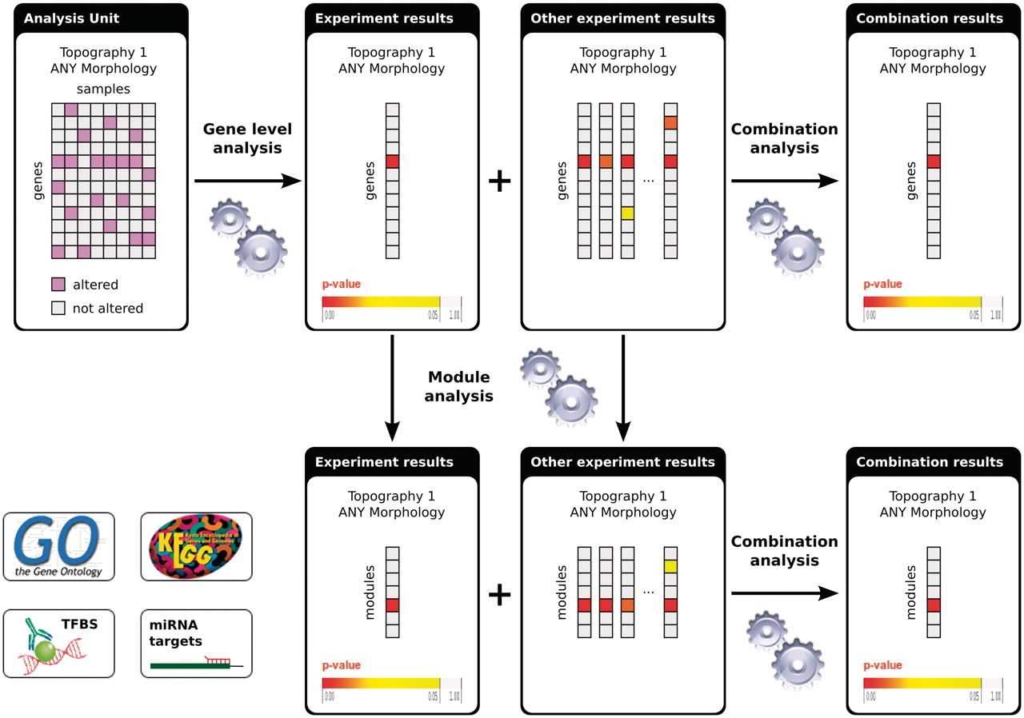
Figure 2. Flowchart of the analyses in IntOGen. Each analysis unit (set of assays from the same study using the same ...
Notes:
Figure 2. Flowchart of the analyses in IntOGen. Each analysis unit (set of assays from the same study using the same platform and annotated with the same ICD-O terms) is analysed to detect the significantly altered genes. The gene-level experiment results are analyzed further to detect significantly altered modules. The experiment results with the same ICD-O terms are combined both at the gene level and at the module level. For methods details see (1).
Unless provided in the caption above, the following copyright applies to the content of this slide: © The Author(s) 2011. Published by Oxford University Press.This is Open Access article distributed under the terms of the Creative Commons Attribution Non-Commercial License (http://creativecommons.org/licenses/by-nc/2.5), which permits unrestricted non-commercial use, distribution, and reproduction in any medium, provided the original work is properly cited.

Slide 3
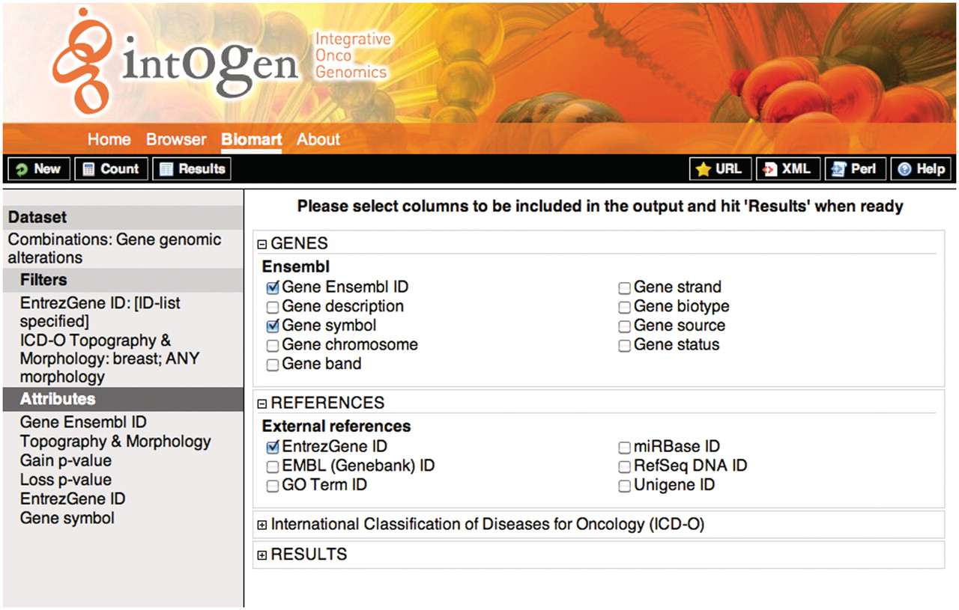
Figure 3. Screenshot showing the attribute selection for the query 1. On the left, the selected dataset, filters and ...
Notes:
Figure 3. Screenshot showing the attribute selection for the query 1. On the left, the selected dataset, filters and attributes are shown. On the right the detailed attributes selection view. To retrieve the results the user should click on the ‘Results’ button on the upper-left black bar, the ‘Count’ button gives the number of rows that match the query and the ‘New’ button allows to start a new query.
Unless provided in the caption above, the following copyright applies to the content of this slide: © The Author(s) 2011. Published by Oxford University Press.This is Open Access article distributed under the terms of the Creative Commons Attribution Non-Commercial License (http://creativecommons.org/licenses/by-nc/2.5), which permits unrestricted non-commercial use, distribution, and reproduction in any medium, provided the original work is properly cited.

