Slide 1
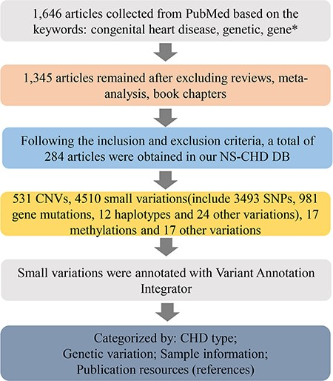
Figure 1 The schematic flow of the NS-CHD data collection and construction. After a series of standard selections, ...
Notes:
Figure 1 The schematic flow of the NS-CHD data collection and construction. After a series of standard selections, there were 284 articles selected from PubMed and incorporated into our database construction.
Unless provided in the caption above, the following copyright applies to the content of this slide: © The Author(s) 2020. Published by Oxford University Press.This is an Open Access article distributed under the terms of the Creative Commons Attribution License (http://creativecommons.org/licenses/by/4.0/), which permits unrestricted reuse, distribution, and reproduction in any medium, provided the original work is properly cited.

