Slide 1
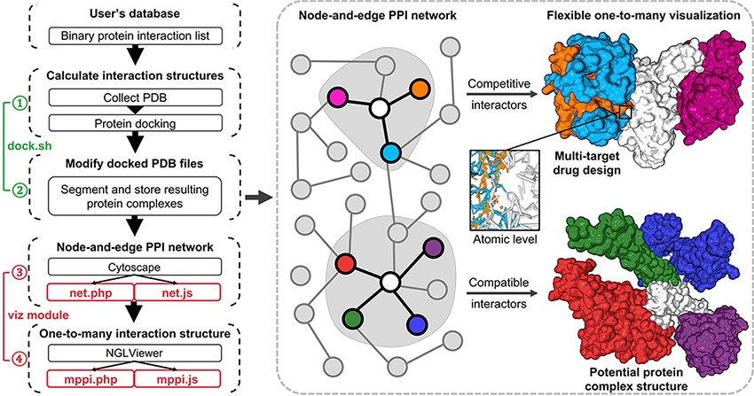
Figure 1. Illustration of mPPI. The left part is the workflow of mPPI. After applying mPPI, the user’s database will ...
Notes:
Figure 1. Illustration of mPPI. The left part is the workflow of mPPI. After applying mPPI, the user’s database will acquire visualization functions demonstrated in the dashed box. In the dashed box, the left part is the 2D network representing binary protein–protein interaction from the user’s database. Any node in the network could be chosen to visualize its multiple interactors. The one-to-many structural presentation is highly flexible that the visibility, scale, angle and presentation style of each interactor can be adjusted for the most intuitive perspective. Two examples are demonstrated on the right side of the dashed box, where the colors correspond between the protein nodes and the 3D structures. Structurally compatible and competitive interactors are selected for visualization to assist protein macro-complex structure prediction and multi-target drug design. Atomic-level presentation is supported to further aid drug design and mechanism discovery, as shown in the middle of the dashed box.
Unless provided in the caption above, the following copyright applies to the content of this slide: © Crown copyright 2021.This Open Access article contains public sector information licensed under the Open Government Licence v2.0 (http://www.nationalarchives.gov.uk/doc/open-government-licence/version/2/).

Slide 2
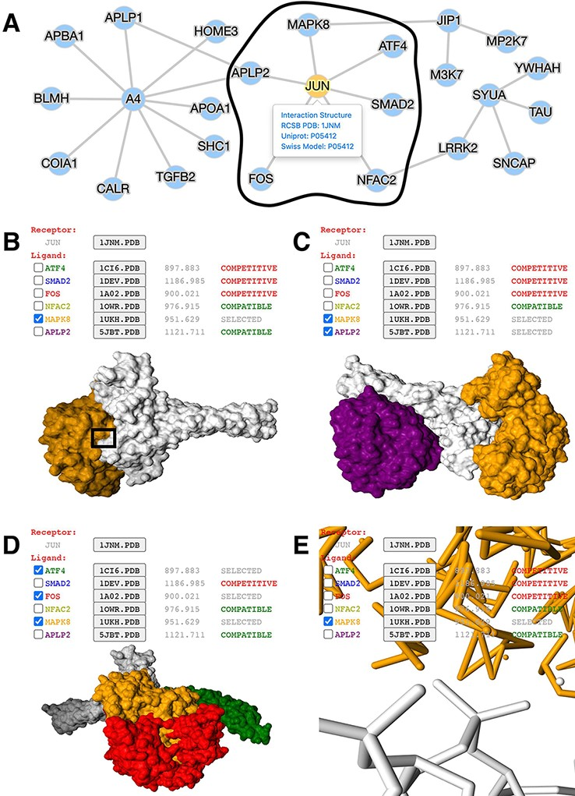
Figure 2. Application of mPPI in a disease-related PPI database. (A) PPI network in node-and-edge representation. This ...
Notes:
Figure 2. Application of mPPI in a disease-related PPI database. (A) PPI network in node-and-edge representation. This example network is a sub-interactome containing 25 proteins related to ND (http://bis.zju.edu.cn/ndatlas/). The black circle stressed out a sub-network center at protein JUN that will be structurally displayed in Fig. 2B–E. (B) Presentation style and logistics of multiway structural interactions in mPPI. When selecting proteins to interact (in this example a protein MAPK8), the selected proteins will be tagged ‘SELECTED’, and all other proteins that are structurally compatible to them will be tagged ‘COMPATIBLE’, while other competitive ligands will be tagged ‘COMPETITIVE’, in the last column of each protein row. The checking and unchecking of each protein will change all the compatibility tags accordingly. (C) Illustration of one-to-many structural interaction. The center protein is JUN (white), and we select two compatible interactors MAPK8 (orange), APLP2 (purple) to visualize. (D) Another illustration of one-to-many structural interaction. The center protein is JUN (white), and interactors ATF4 (green), FOS (red) and MAPK8 (orange) are competitive. (E) PPI conformation at atomic resolution. The partial image of structural interaction stressed out in black box in Fig. 2B intuitively displays the binding interface of JUN and MAPK8. For each protein ligands, the docked structures can be downloaded for users’ further analysis by clicking the ‘.PDB’ button behind each protein name, and the docking scores (representing the tightness of the interaction calculated by ZDOCK) are shown behind each ‘.PDB’ button.
Unless provided in the caption above, the following copyright applies to the content of this slide: © Crown copyright 2021.This Open Access article contains public sector information licensed under the Open Government Licence v2.0 (http://www.nationalarchives.gov.uk/doc/open-government-licence/version/2/).

