Slide 1
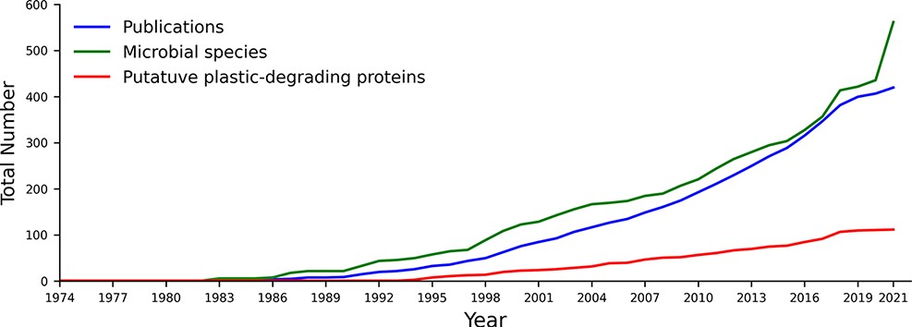
Figure 1. The cumulative number of publications, microbial species and proteins reported to degrade plastics between ...
Notes:
Figure 1. The cumulative number of publications, microbial species and proteins reported to degrade plastics between 1974 and August 2021. All included data fit our criteria for putative plastics degradation, as outlined in the methods.
Unless provided in the caption above, the following copyright applies to the content of this slide: © The Author(s) 2022. Published by Oxford University Press.This is an Open Access article distributed under the terms of the Creative Commons Attribution License (https://creativecommons.org/licenses/by/4.0/), which permits unrestricted reuse, distribution, and reproduction in any medium, provided the original work is properly cited.

Slide 2
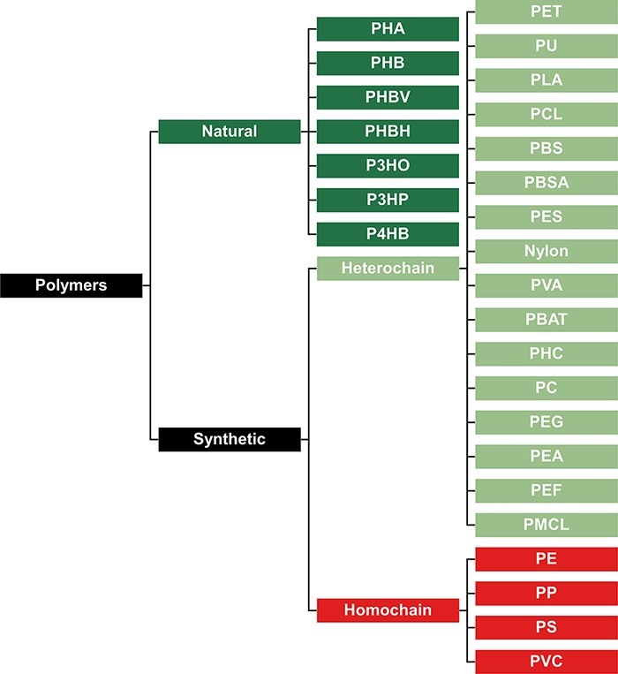
Figure 2. Classification of polymers to represent their presumed biodegradation potential. Natural polymers are more ...
Notes:
Figure 2. Classification of polymers to represent their presumed biodegradation potential. Natural polymers are more biodegradable, synthetic heterochain polymers have an intermediate biodegradability, and synthetic homochain polymers are the least biodegradable.
Unless provided in the caption above, the following copyright applies to the content of this slide: © The Author(s) 2022. Published by Oxford University Press.This is an Open Access article distributed under the terms of the Creative Commons Attribution License (https://creativecommons.org/licenses/by/4.0/), which permits unrestricted reuse, distribution, and reproduction in any medium, provided the original work is properly cited.

Slide 3
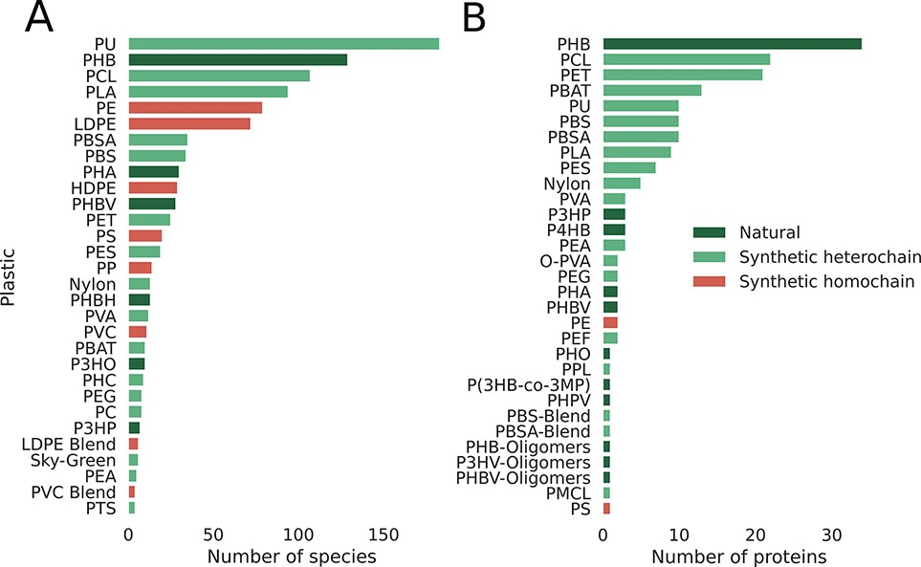
Figure 3. Database statistics per plastic, emphasizing the smaller number of reports for synthetic homochain polymers ...
Notes:
Figure 3. Database statistics per plastic, emphasizing the smaller number of reports for synthetic homochain polymers (those composed of only C–C backbones). A) Number of microbial species reported to degrade plastics. B) Number of proteins reported to break down plastics categorized by plastic type.
Unless provided in the caption above, the following copyright applies to the content of this slide: © The Author(s) 2022. Published by Oxford University Press.This is an Open Access article distributed under the terms of the Creative Commons Attribution License (https://creativecommons.org/licenses/by/4.0/), which permits unrestricted reuse, distribution, and reproduction in any medium, provided the original work is properly cited.

Slide 4
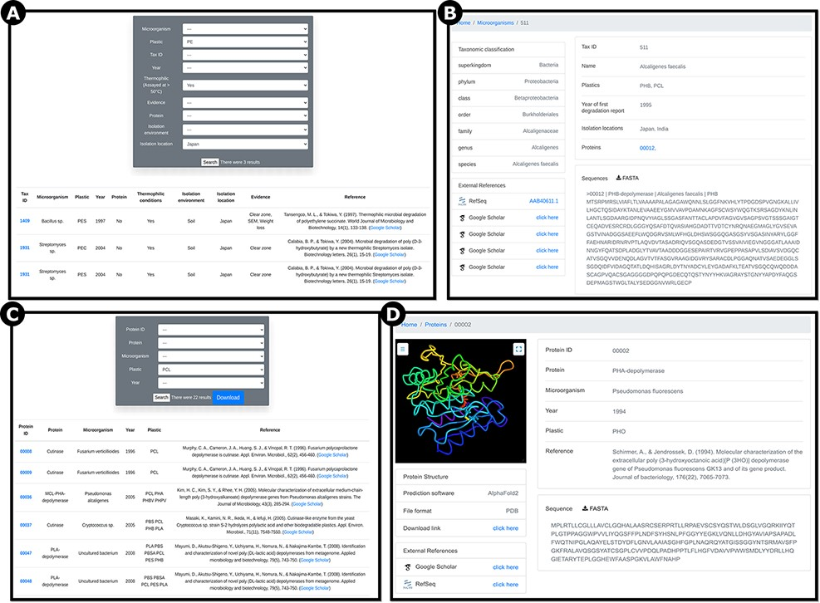
Figure 4. Screenshots of example pages showing information on reported plastic-degrading microorganisms and proteins. ...
Notes:
Figure 4. Screenshots of example pages showing information on reported plastic-degrading microorganisms and proteins. A) ‘Microorganisms’ page showing search results filtered for polyethylene (PE), thermophilic organisms, and isolation location in Japan; B) ‘Microorganisms’ page outputs showing Alcaligenes faecalis, a bacterium reported to degrade PHB and PCL; C) ‘Proteins’ page showing 22 results for the plastic type polycaprolactone (PCL). D) ‘Proteins’ page showing Pseudomonas fluorescens PHA-depolymerase, reported to break down polyhydroxyoctanoate (PHO; RefSeq ID AAA64538.1). Users can visualize the predicted protein structure, download the prediction in PDB file format and download the sequence in FASTA file format.
Unless provided in the caption above, the following copyright applies to the content of this slide: © The Author(s) 2022. Published by Oxford University Press.This is an Open Access article distributed under the terms of the Creative Commons Attribution License (https://creativecommons.org/licenses/by/4.0/), which permits unrestricted reuse, distribution, and reproduction in any medium, provided the original work is properly cited.

Slide 5
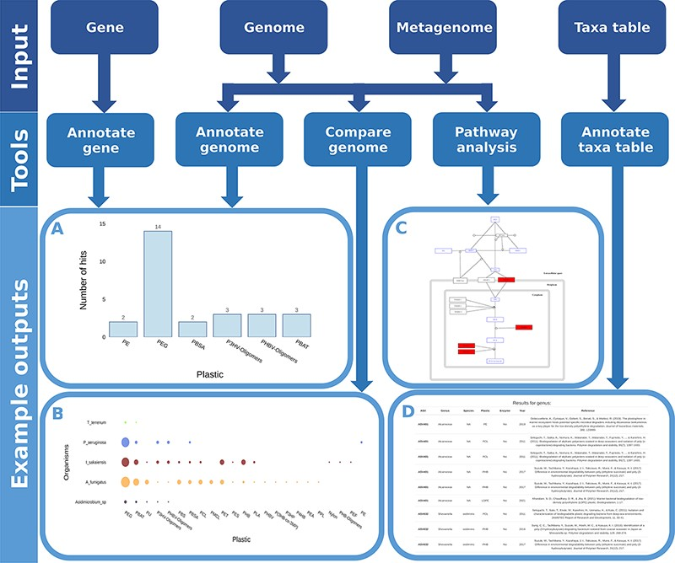
Figure 5. Flow chart showing all possible inputs, respective tools and example outputs for each data type. A) The ...
Notes:
Figure 5. Flow chart showing all possible inputs, respective tools and example outputs for each data type. A) The Ideonella sakaiensis genome was used as an input for the ‘Annotate Genome’ tool, showing the number of input proteins that matched database proteins, grouped by plastic type. B) Comparison of plastic biodegradation potential for the genomes of Ideonella sakaiensis, Agaricus bisporus, P. aeruginosa and Aspergillus fumigatus. C) The P. aeruginosa genome was also used as the input for the ‘Pathway Analysis’ tool. Open blue rectangles represent substrates, solid red rectangles represent proteins in the pathway present in the P. aeruginosa genome, and open black rectangles represent proteins not present in the genome. D) An example output table generated by the ‘Annotate Taxa Table’ tool using amplicon sequencing data as the input. All figures are available at higher resolution in the supplementary material.
Unless provided in the caption above, the following copyright applies to the content of this slide: © The Author(s) 2022. Published by Oxford University Press.This is an Open Access article distributed under the terms of the Creative Commons Attribution License (https://creativecommons.org/licenses/by/4.0/), which permits unrestricted reuse, distribution, and reproduction in any medium, provided the original work is properly cited.

Slide 6
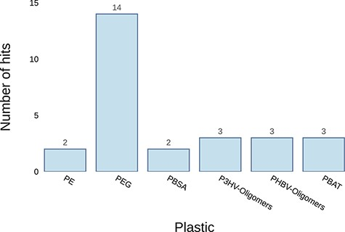
Figure 6. Example graph output from the ‘Annotate Genome’ tool. It plots the number of results returned for putative ...
Notes:
Figure 6. Example graph output from the ‘Annotate Genome’ tool. It plots the number of results returned for putative plastic-degrading proteins per plastic type. The input datum was the genome of Pseudomonas aeruginosa.
Unless provided in the caption above, the following copyright applies to the content of this slide: © The Author(s) 2022. Published by Oxford University Press.This is an Open Access article distributed under the terms of the Creative Commons Attribution License (https://creativecommons.org/licenses/by/4.0/), which permits unrestricted reuse, distribution, and reproduction in any medium, provided the original work is properly cited.

Slide 7
Figure 7. Example graph output from the ‘Compare Genome’ tool. The tool plots the number of hits for putative ...
Notes:
Figure 7. Example graph output from the ‘Compare Genome’ tool. The tool plots the number of hits for putative plastic-degrading proteins per plastic type for each dataset. The size of the dots represents the number of hits found in each genome for each plastic. The input data were the genomes of Thermobaculum terrenum, Pseudomonas aeruginosa, Ideonella sakaiensis, Aspergillus fumigatus and Acidimicrobium sp.
Unless provided in the caption above, the following copyright applies to the content of this slide: © The Author(s) 2022. Published by Oxford University Press.This is an Open Access article distributed under the terms of the Creative Commons Attribution License (https://creativecommons.org/licenses/by/4.0/), which permits unrestricted reuse, distribution, and reproduction in any medium, provided the original work is properly cited.

Slide 8
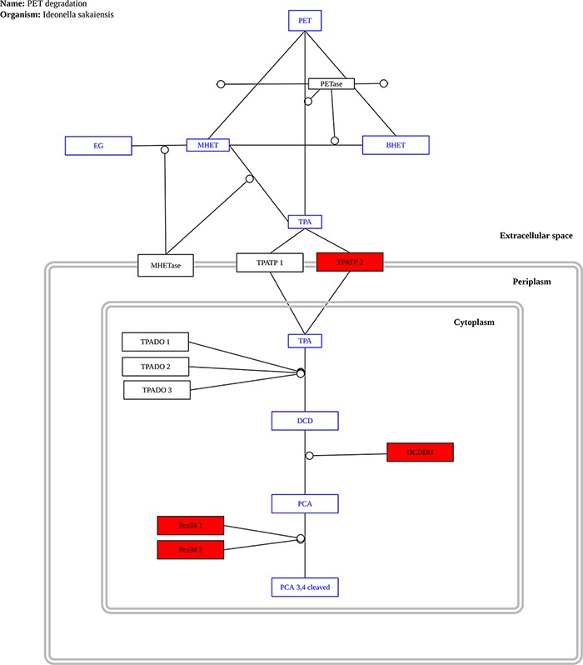
Figure 8. Example graph output from the ‘Pathway Analysis’ tool. Black rectangles represent proteins, blue rectangles ...
Notes:
Figure 8. Example graph output from the ‘Pathway Analysis’ tool. Black rectangles represent proteins, blue rectangles represent substrates and red rectangles represent proteins present in the genome or metagenome being investigated, in this case, the genome of the bacterium P. aeruginosa.
Unless provided in the caption above, the following copyright applies to the content of this slide: © The Author(s) 2022. Published by Oxford University Press.This is an Open Access article distributed under the terms of the Creative Commons Attribution License (https://creativecommons.org/licenses/by/4.0/), which permits unrestricted reuse, distribution, and reproduction in any medium, provided the original work is properly cited.

Slide 9
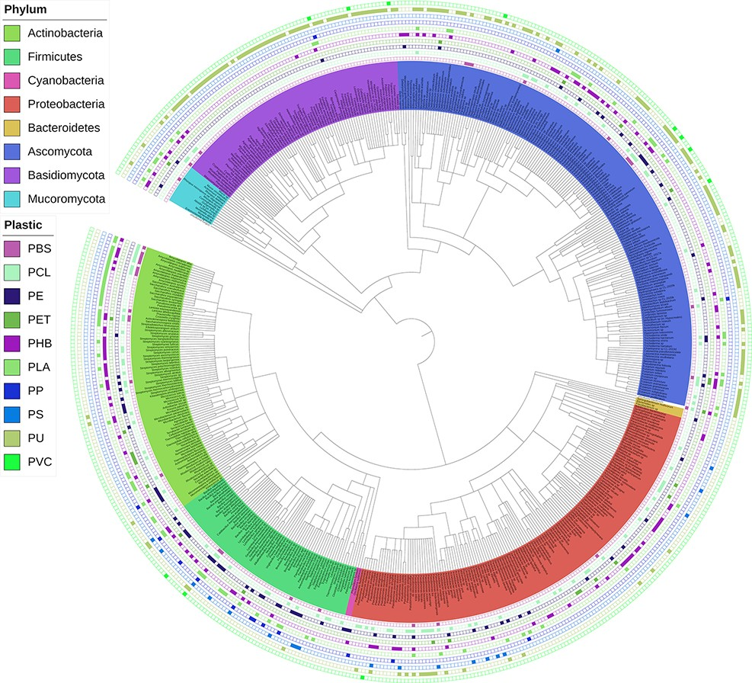
Figure 9. Interactive phylogenetic tree showing all microbes in the database and their respective plastic degradation ...
Notes:
Figure 9. Interactive phylogenetic tree showing all microbes in the database and their respective plastic degradation reports. This figure is updated regularly with new reports of microbial degradation. Available at plasticdb.org/interactive_tree.
Unless provided in the caption above, the following copyright applies to the content of this slide: © The Author(s) 2022. Published by Oxford University Press.This is an Open Access article distributed under the terms of the Creative Commons Attribution License (https://creativecommons.org/licenses/by/4.0/), which permits unrestricted reuse, distribution, and reproduction in any medium, provided the original work is properly cited.

