Slide 1
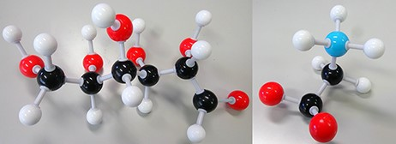
Figure 1. Disease biomarkers; Black, Grey, Red and Blue sphere colors correspond to C, H, O and N, respectively. (i) ...
Notes:
Figure 1. Disease biomarkers; Black, Grey, Red and Blue sphere colors correspond to C, H, O and N, respectively. (i) Diabetes biomarker (Glucose—C6H12O6). (ii) Encephalopathy biomarker (Glycine—C2H5NO2).
Unless provided in the caption above, the following copyright applies to the content of this slide: © The Author(s) 2021. Published by Oxford University Press.This is an Open Access article distributed under the terms of the Creative Commons Attribution License (http://creativecommons.org/licenses/by/4.0/), which permits unrestricted reuse, distribution, and reproduction in any medium, provided the original work is properly cited.

Slide 2
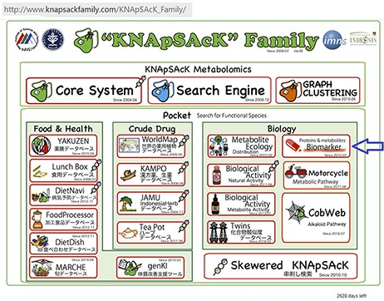
Figure 2. The main window of the KNApSAcK family databases and the arrow indicating the biomarker icon.
Notes:
Figure 2. The main window of the KNApSAcK family databases and the arrow indicating the biomarker icon.
Unless provided in the caption above, the following copyright applies to the content of this slide: © The Author(s) 2021. Published by Oxford University Press.This is an Open Access article distributed under the terms of the Creative Commons Attribution License (http://creativecommons.org/licenses/by/4.0/), which permits unrestricted reuse, distribution, and reproduction in any medium, provided the original work is properly cited.

Slide 3
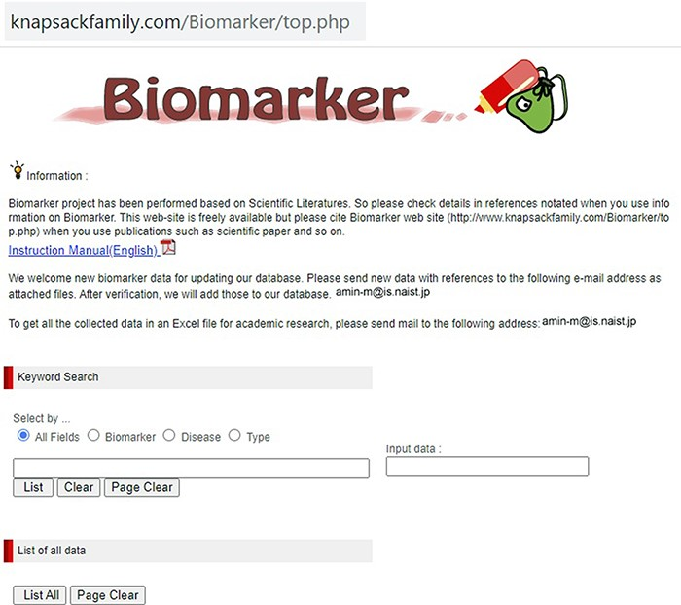
Figure 3. The main window of the biomarker database.
Notes:
Figure 3. The main window of the biomarker database.
Unless provided in the caption above, the following copyright applies to the content of this slide: © The Author(s) 2021. Published by Oxford University Press.This is an Open Access article distributed under the terms of the Creative Commons Attribution License (http://creativecommons.org/licenses/by/4.0/), which permits unrestricted reuse, distribution, and reproduction in any medium, provided the original work is properly cited.

Slide 4
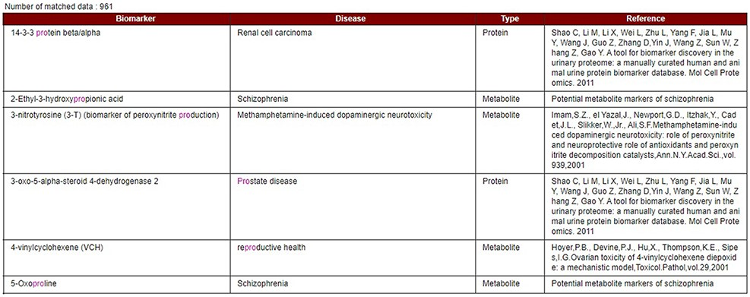
Figure 4. Data display based on partial or exact string matching search.
Notes:
Figure 4. Data display based on partial or exact string matching search.
Unless provided in the caption above, the following copyright applies to the content of this slide: © The Author(s) 2021. Published by Oxford University Press.This is an Open Access article distributed under the terms of the Creative Commons Attribution License (http://creativecommons.org/licenses/by/4.0/), which permits unrestricted reuse, distribution, and reproduction in any medium, provided the original work is properly cited.

Slide 5
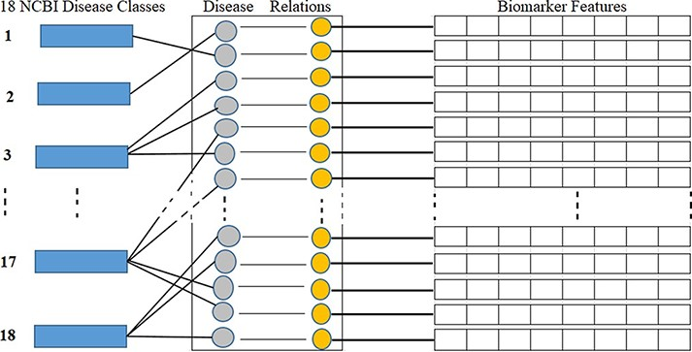
Figure 5. Disease classes, disease-biomarker relations and biomarker feature connectivity.
Notes:
Figure 5. Disease classes, disease-biomarker relations and biomarker feature connectivity.
Unless provided in the caption above, the following copyright applies to the content of this slide: © The Author(s) 2021. Published by Oxford University Press.This is an Open Access article distributed under the terms of the Creative Commons Attribution License (http://creativecommons.org/licenses/by/4.0/), which permits unrestricted reuse, distribution, and reproduction in any medium, provided the original work is properly cited.

Slide 6
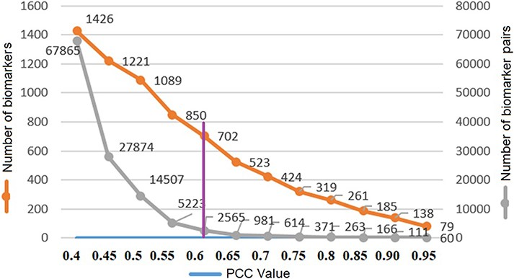
Figure 6. Threshold PCC value selection.
Notes:
Figure 6. Threshold PCC value selection.
Unless provided in the caption above, the following copyright applies to the content of this slide: © The Author(s) 2021. Published by Oxford University Press.This is an Open Access article distributed under the terms of the Creative Commons Attribution License (http://creativecommons.org/licenses/by/4.0/), which permits unrestricted reuse, distribution, and reproduction in any medium, provided the original work is properly cited.

Slide 7
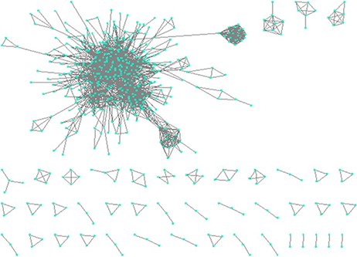
Figure 7. Constructing network based on structural similarity between biomarkers; Nodes represent proteins and edges ...
Notes:
Figure 7. Constructing network based on structural similarity between biomarkers; Nodes represent proteins and edges represent structure similarity.
Unless provided in the caption above, the following copyright applies to the content of this slide: © The Author(s) 2021. Published by Oxford University Press.This is an Open Access article distributed under the terms of the Creative Commons Attribution License (http://creativecommons.org/licenses/by/4.0/), which permits unrestricted reuse, distribution, and reproduction in any medium, provided the original work is properly cited.

Slide 8
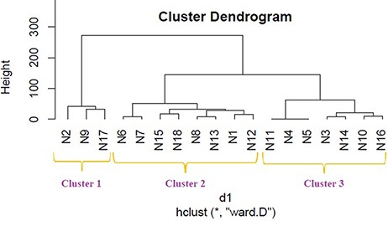
Figure 8. Disease classification dendrogram based on protein biomarkers.
Notes:
Figure 8. Disease classification dendrogram based on protein biomarkers.
Unless provided in the caption above, the following copyright applies to the content of this slide: © The Author(s) 2021. Published by Oxford University Press.This is an Open Access article distributed under the terms of the Creative Commons Attribution License (http://creativecommons.org/licenses/by/4.0/), which permits unrestricted reuse, distribution, and reproduction in any medium, provided the original work is properly cited.

Slide 9
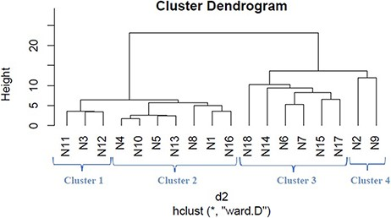
Figure 9. Disease classification dendrogram based on metabolite biomarkers.
Notes:
Figure 9. Disease classification dendrogram based on metabolite biomarkers.
Unless provided in the caption above, the following copyright applies to the content of this slide: © The Author(s) 2021. Published by Oxford University Press.This is an Open Access article distributed under the terms of the Creative Commons Attribution License (http://creativecommons.org/licenses/by/4.0/), which permits unrestricted reuse, distribution, and reproduction in any medium, provided the original work is properly cited.

Slide 10
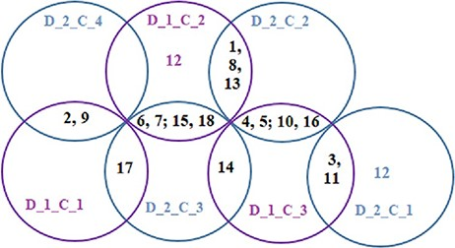
Figure 10. Venn diagrams showing common disease classes between protein and metabolite biomarker-based clusters; 3 ...
Notes:
Figure 10. Venn diagrams showing common disease classes between protein and metabolite biomarker-based clusters; 3 magenta circles are the Clusters 1, 2 and 3 of Figure 8 and 4 green circles are the Clusters 1, 2, 3 and 4 of Figure 9.
Unless provided in the caption above, the following copyright applies to the content of this slide: © The Author(s) 2021. Published by Oxford University Press.This is an Open Access article distributed under the terms of the Creative Commons Attribution License (http://creativecommons.org/licenses/by/4.0/), which permits unrestricted reuse, distribution, and reproduction in any medium, provided the original work is properly cited.

