Slide 1
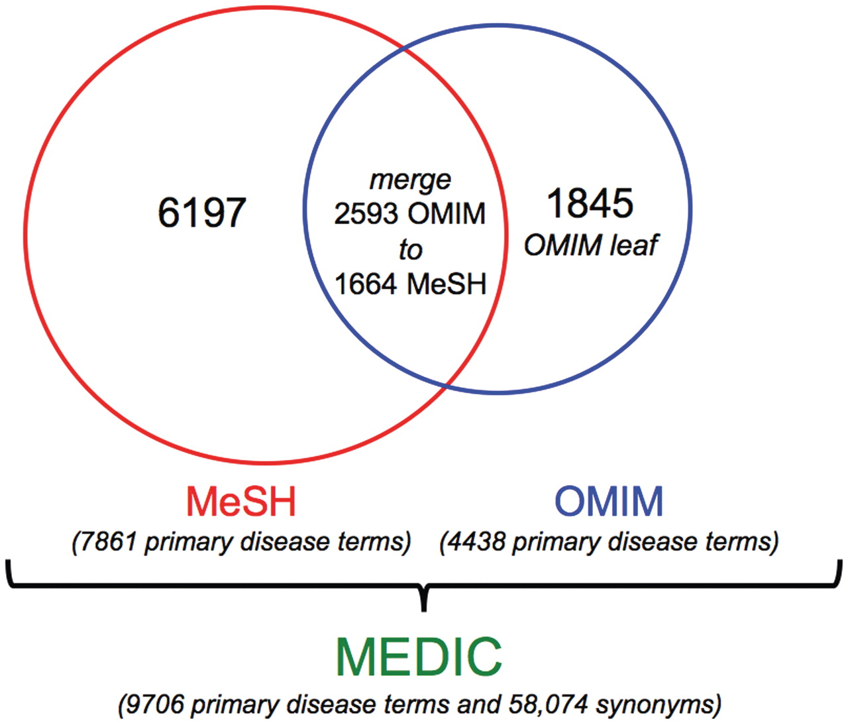
Figure 2. Components of MEDIC. As of October 2011, MEDIC contained 9706 unique disease primary terms and 58 074 ...
Notes:
Figure 2. Components of MEDIC. As of October 2011, MEDIC contained 9706 unique disease primary terms and 58 074 synonyms. It includes 6197 MeSH primary terms, 1845 OMIM primary terms (as leaf nodes) and 1664 MeSH primary terms (that have 2593 OMIM primary terms merged to them).
Unless provided in the caption above, the following copyright applies to the content of this slide: © The Author(s) 2012. Published by Oxford University Press.This is an Open Access article distributed under the terms of the Creative Commons Attribution Non-Commercial License (http://creativecommons.org/licenses/by-nc/3.0), which permits unrestricted non-commercial use, distribution, and reproduction in any medium, provided the original work is properly cited.

