Slide 1
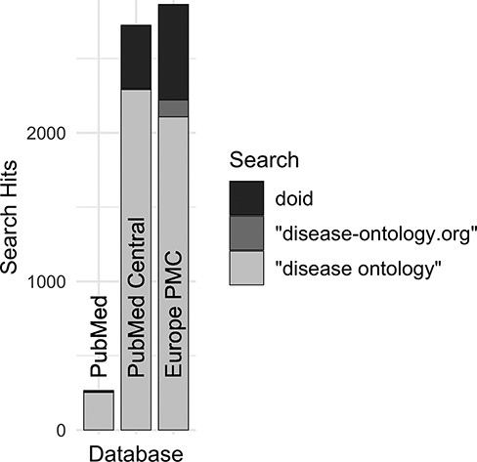
Figure 4. Comparison of search hits at different publication databases for the three keyword searches with the greatest ...
Notes:
Figure 4. Comparison of search hits at different publication databases for the three keyword searches with the greatest number of hits at Europe PMC. These case-insensitive searches identify mentions of DO’s specific identifier, the official website or the ontology itself without ‘Human’, which is often left out by users.
Unless provided in the caption above, the following copyright applies to the content of this slide: © The Author(s) 2023. Published by Oxford University Press.This is an Open Access article distributed under the terms of the Creative Commons Attribution License (https://creativecommons.org/licenses/by/4.0/), which permits unrestricted reuse, distribution, and reproduction in any medium, provided the original work is properly cited.

