Slide 1
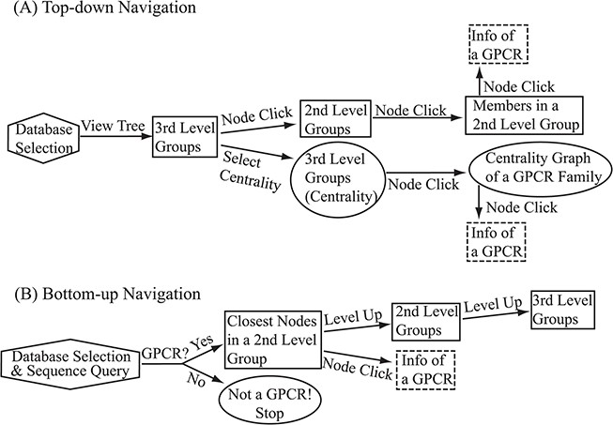
Figure 6 Flowchart of the two navigation interfaces of the SeQuery database, including the top-down navigation scheme ...
Notes:
Figure 6 Flowchart of the two navigation interfaces of the SeQuery database, including the top-down navigation scheme (A) and the bottom-up navigation scheme (B). Source databases are represented by hexagons. In the top-down and bottom-up interface designs, we use solid squares to represent generated MSC graphs and ovals to represent alternative centrality graphs or warnings of detected non-GPCR. Dashed squares represent modal boxes providing information about a GPCR sequence when its corresponding node is clicked.
Unless provided in the caption above, the following copyright applies to the content of this slide: © The Author(s) 2019. Published by Oxford University Press.This is an Open Access article distributed under the terms of the Creative Commons Attribution License (http://creativecommons.org/licenses/by/4.0/), which permits unrestricted reuse, distribution, and reproduction in any medium, provided the original work is properly cited.

