Slide 1
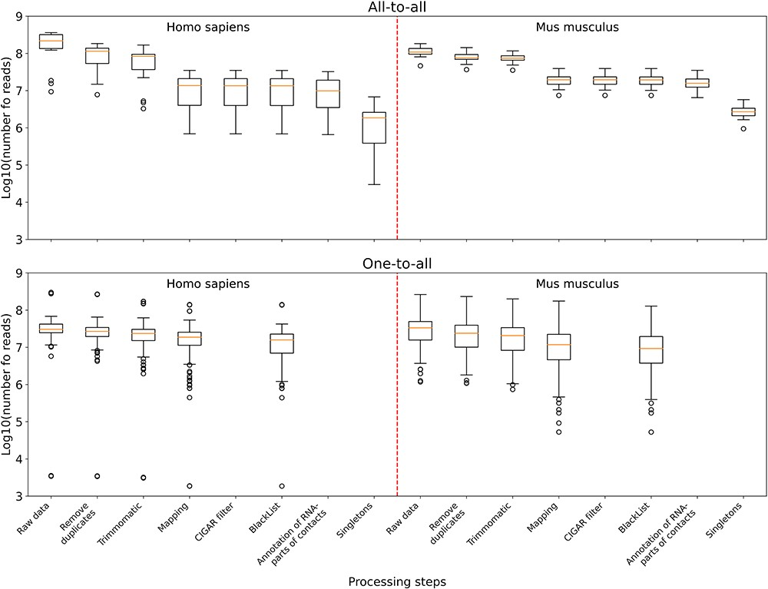
Figure 3. The distribution of the number of reads in the data sets left after the corresponding processing step and all ...
Notes:
Figure 3. The distribution of the number of reads in the data sets left after the corresponding processing step and all the previous ones. Upper panel: boxplots plotted from all-to-all data, namely 17 human data sets and 18 mouse data sets. Lower panel: boxplots plotted from one-to-all data, namely 159 human data sets and 291 mouse data sets.
Unless provided in the caption above, the following copyright applies to the content of this slide: © The Author(s) 2023. Published by Oxford University Press.This is an Open Access article distributed under the terms of the Creative Commons Attribution License (https://creativecommons.org/licenses/by/4.0/), which permits unrestricted reuse, distribution, and reproduction in any medium, provided the original work is properly cited.

