Slide 1
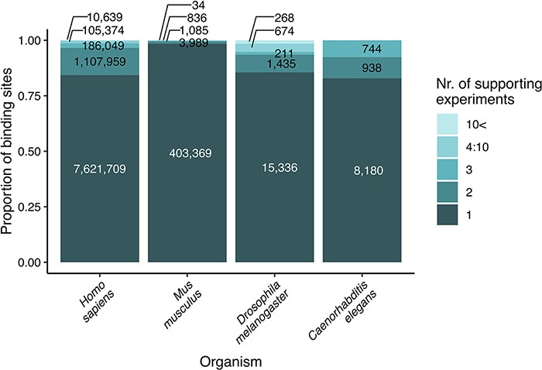
Figure 1. Strength of evidence (number of supporting experiments) for each transcription factor binding site, referring ...
Notes:
Figure 1. Strength of evidence (number of supporting experiments) for each transcription factor binding site, referring to the number of binding sites (for a particular transcription factor) that overlap (in at least one nucleotide length) with the investigated binding site. The original data are included as binding site tables in the download parts of the TFLink database.
Unless provided in the caption above, the following copyright applies to the content of this slide: © The Author(s) 2022. Published by Oxford University Press.This is an Open Access article distributed under the terms of the Creative Commons Attribution-NonCommercial License (https://creativecommons.org/licenses/by-nc/4.0/), which permits non-commercial re-use, distribution, and reproduction in any medium, provided the original work is properly cited. For commercial re-use, please contact journals.permissions@oup.com

Slide 2
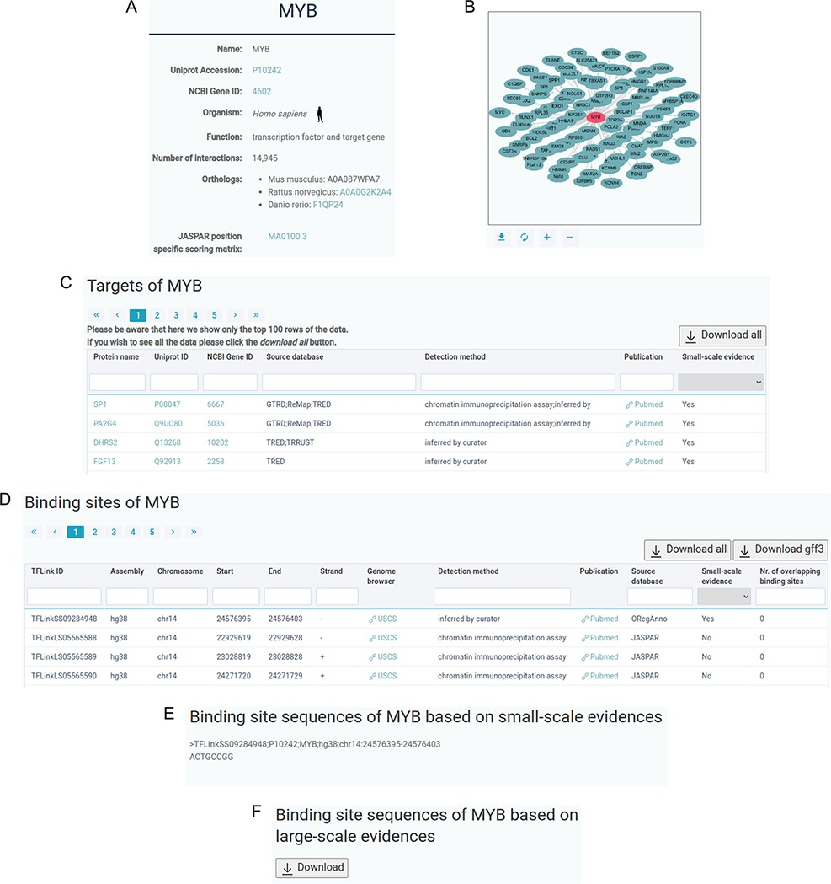
Figure 2. Sample content of a TFLink entry page. (A) Basic information about the transcription factor or target gene. ...
Notes:
Figure 2. Sample content of a TFLink entry page. (A) Basic information about the transcription factor or target gene. (B) Visualization of the interaction network of the transcription factor (red) and its target genes (green). (C) Table containing information about the target genes. (D) Table containing genomic location of the binding sites. (E) Transcription factor binding site sequences in FASTA format, based on small-scale evidences. (F) Downloadable FASTA file containing transcription factor binding site sequences based on large-scale evidences.
Unless provided in the caption above, the following copyright applies to the content of this slide: © The Author(s) 2022. Published by Oxford University Press.This is an Open Access article distributed under the terms of the Creative Commons Attribution-NonCommercial License (https://creativecommons.org/licenses/by-nc/4.0/), which permits non-commercial re-use, distribution, and reproduction in any medium, provided the original work is properly cited. For commercial re-use, please contact journals.permissions@oup.com

