Slide 1
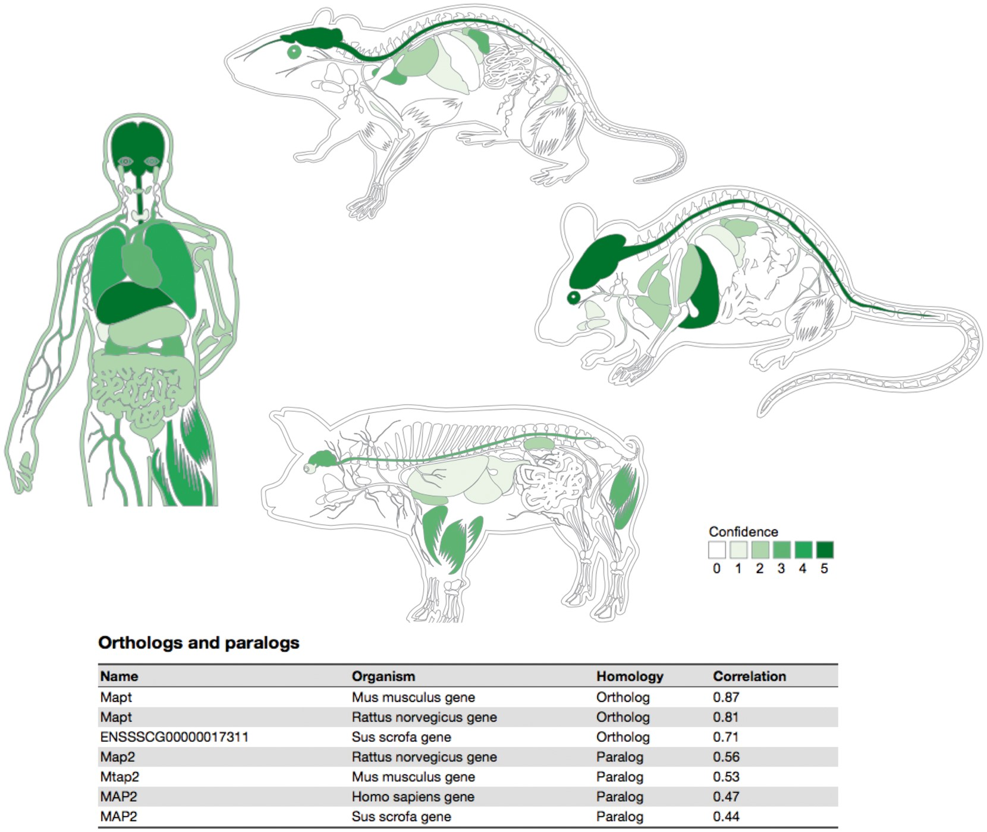
Figure 5. Summary figures for all the covered organisms. The web interface provides a comprehensive figure for each ...
Notes:
Figure 5. Summary figures for all the covered organisms. The web interface provides a comprehensive figure for each organism where the tissue associations for the queried gene are summarized. In this example, we are showing the tissue expression profile for the Microtubule-associated protein tau (MAPT) known to be related to Alzheimer’s disease (57). The ortholog–paralog table provides information about homologous proteins and their tissue–expression correlation with the query protein.
Unless provided in the caption above, the following copyright applies to the content of this slide: © The Author(s) 2018. Published by Oxford University Press.This is an Open Access article distributed under the terms of the Creative Commons Attribution License (http://creativecommons.org/licenses/by/4.0/), which permits unrestricted reuse, distribution, and reproduction in any medium, provided the original work is properly cited.

