Slide 1
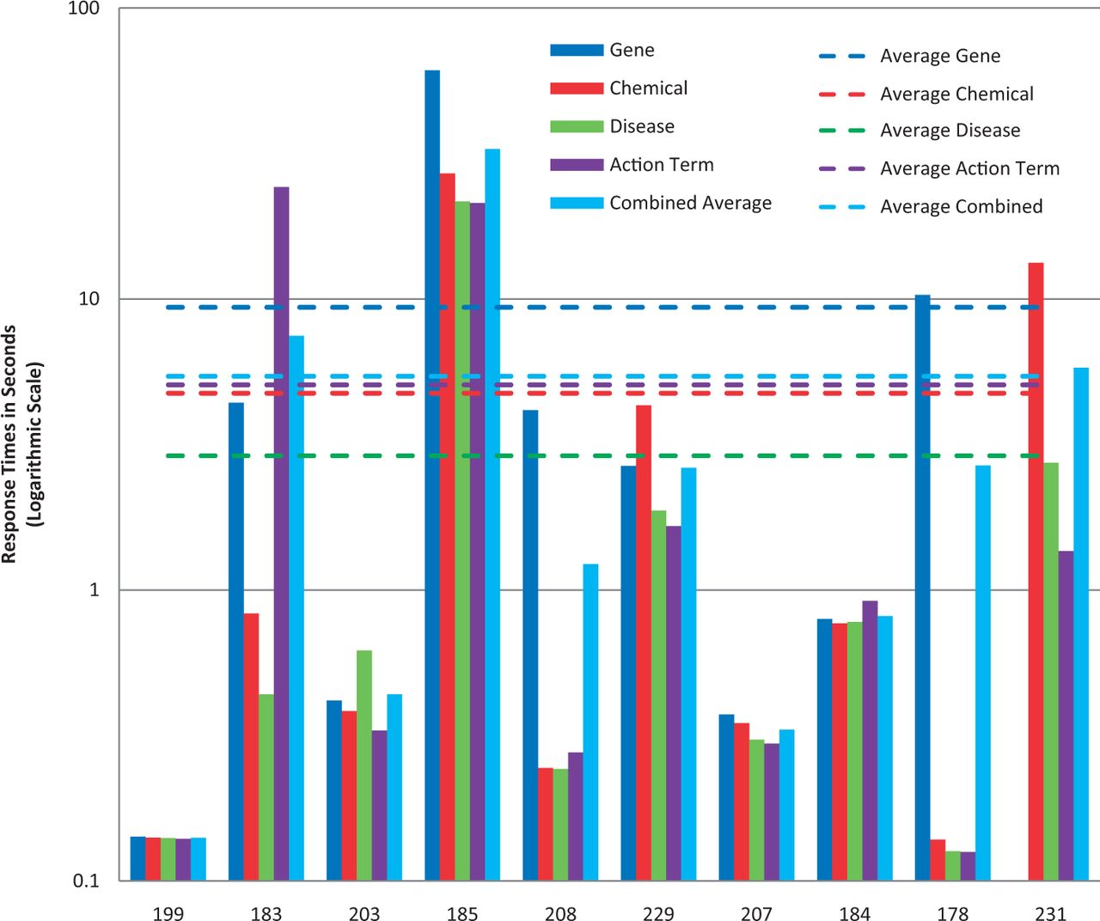
Figure 6. Response times. Response time results for each NER category, as well as a combined average, are provided for ...
Notes:
Figure 6. Response times. Response time results for each NER category, as well as a combined average, are provided for each participating group (anonymously identified by group number on x-axis). Note : the response time in seconds (y-axis) uses a logarithmic scale.
Unless provided in the caption above, the following copyright applies to the content of this slide: © The Author(s) 2014. Published by Oxford University Press.This is an Open Access article distributed under the terms of the Creative Commons Attribution License (http://creativecommons.org/licenses/by/3.0/), which permits unrestricted reuse, distribution, and reproduction in any medium, provided the original work is properly cited.

