Slide 1
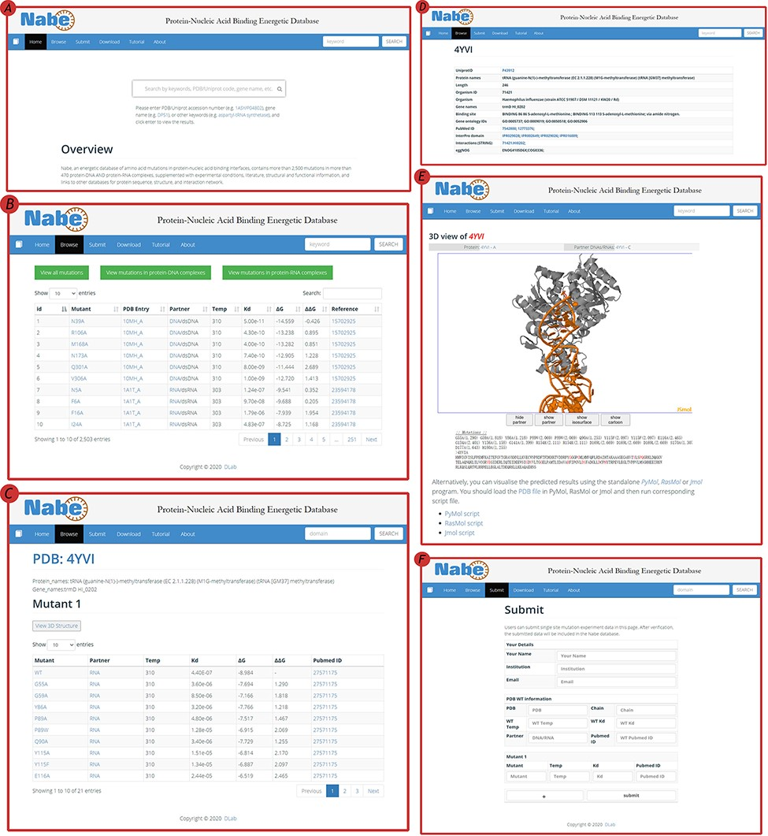
Figure 4. User interface of the Nabe database. (A) The Home page with a quick search box. (B) The Browse web page. (C) ...
Notes:
Figure 4. User interface of the Nabe database. (A) The Home page with a quick search box. (B) The Browse web page. (C) The mutants page of a protein–nucleic acid complex. (D) The detail page of a protein–nucleic acid complex. (E) The 3D model of a protein–nucleic acid complex. (F) The Submit web page.
Unless provided in the caption above, the following copyright applies to the content of this slide: © The Author(s) 2021. Published by Oxford University Press.This is an Open Access article distributed under the terms of the Creative Commons Attribution License (http://creativecommons.org/licenses/by/4.0/), which permits unrestricted reuse, distribution, and reproduction in any medium, provided the original work is properly cited.

