Slide 1
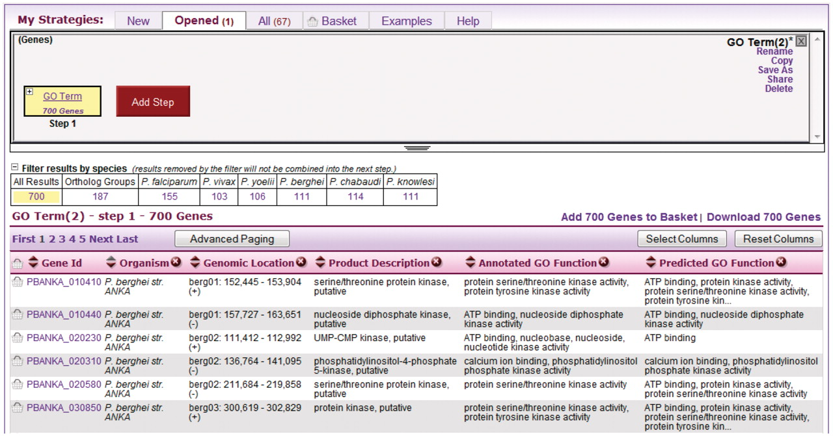
Figure 2. A single-step strategy. This is what the user sees after running a new search, in this case a search for ...
Notes:
Figure 2. A single-step strategy. This is what the user sees after running a new search, in this case a search for genes by GO term. The user clicks the Add Step button (red) to add another search to the strategy.
Unless provided in the caption above, the following copyright applies to the content of this slide: © The Author(s) 2011. Published by Oxford University Press.This is Open Access article distributed under the terms of the Creative Commons Attribution Non-Commercial License (http://creativecommons.org/licenses/by-nc/2.5), which permits unrestricted non-commercial use, distribution, and reproduction in any medium, provided the original work is properly cited.

