Slide 1
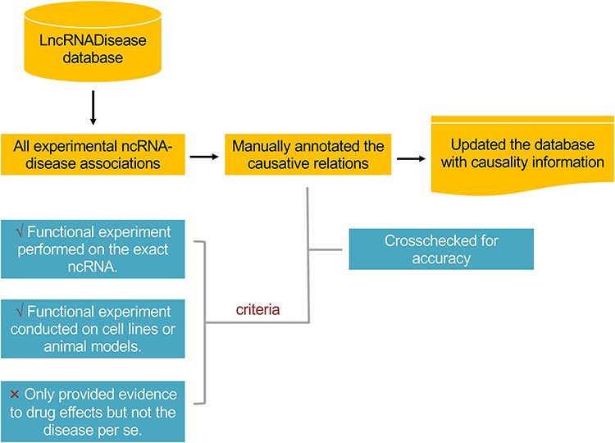
Figure 1 The workflow in annotating the causality information for lncRNA– and circRNA–disease associations.
Notes:
Figure 1 The workflow in annotating the causality information for lncRNA– and circRNA–disease associations.
Unless provided in the caption above, the following copyright applies to the content of this slide: © The Author(s) 2020. Published by Oxford University Press. All rights reserved. For Permissions, please email: journals.permissions@oup.comThis is an Open Access article distributed under the terms of the Creative Commons Attribution License (http://creativecommons.org/licenses/by/4.0/), which permits unrestricted reuse, distribution, and reproduction in any medium, provided the original work is properly cited.

Slide 2
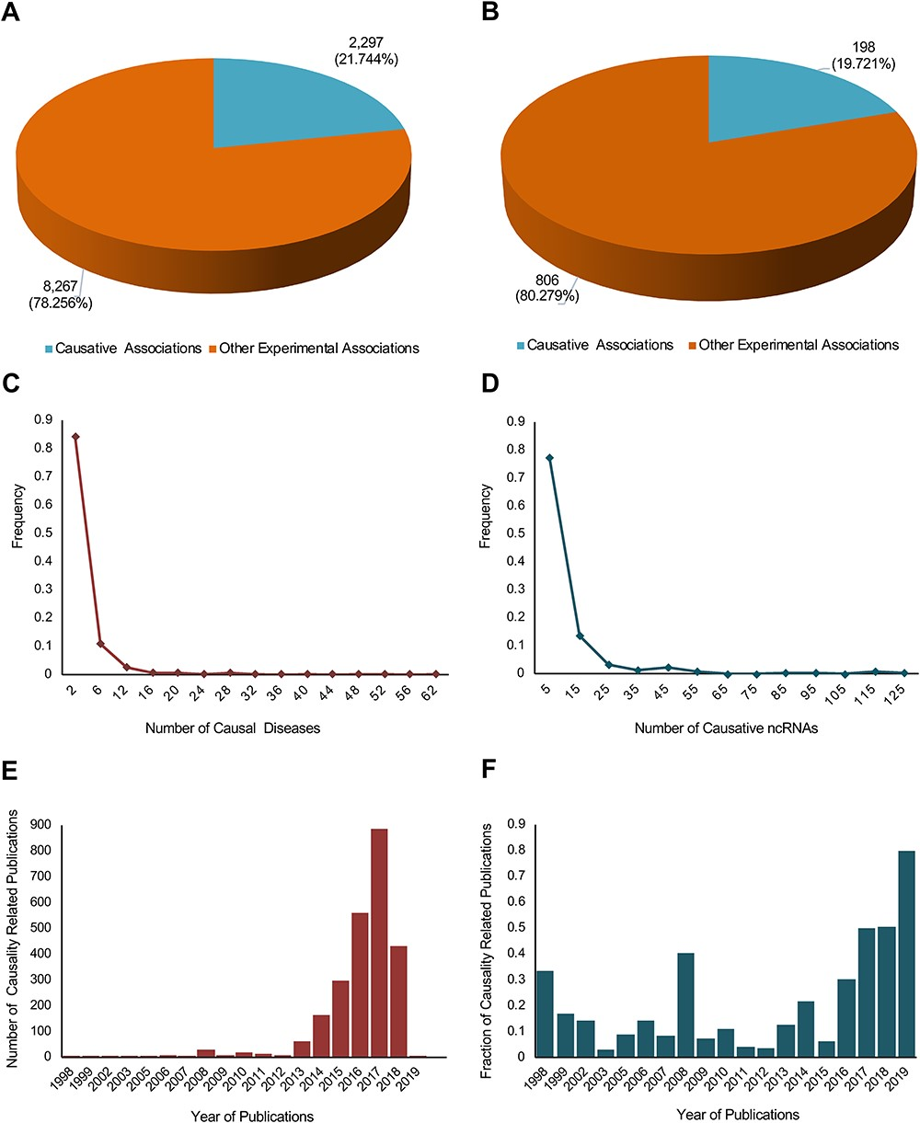
Figure 2 A statistical profile of the causality information of the new update of lncRNADisease. Pie charts show the ...
Notes:
Figure 2 A statistical profile of the causality information of the new update of lncRNADisease. Pie charts show the distribution of causal lncRNA–disease (A) and circRNA–disease (B) associations. In total, 2297 out of 10 564 lncRNA–disease associations and 198 out of 1004 circRNA–disease associations were identified to be causal. Distribution plots show the number of causal diseases for causative ncRNAs (C) and the number of causative ncRNAs for causal diseases (D). Bar plots show the number of causality related publications (E) and the fraction of causality related publications (F).
Unless provided in the caption above, the following copyright applies to the content of this slide: © The Author(s) 2020. Published by Oxford University Press. All rights reserved. For Permissions, please email: journals.permissions@oup.comThis is an Open Access article distributed under the terms of the Creative Commons Attribution License (http://creativecommons.org/licenses/by/4.0/), which permits unrestricted reuse, distribution, and reproduction in any medium, provided the original work is properly cited.

Slide 3
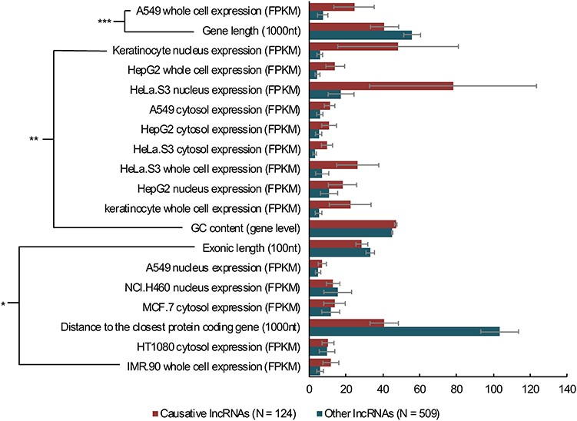
Figure 3 The comparisons between causative and other human lncRNAs. Wilcoxon rank-sum tests were performed on the ...
Notes:
Figure 3 The comparisons between causative and other human lncRNAs. Wilcoxon rank-sum tests were performed on the webserver of LnCompare for comparison analyses of 124 causative human lncRNAs and 509 other (manually annotated as non-causative) human lncRNAs using 109 features. The analysis only performed on lncRNAs with Ensembl IDs. *P < 0.05, **P < 0.01, ***P < 0.001, error bars show the SEM.
Unless provided in the caption above, the following copyright applies to the content of this slide: © The Author(s) 2020. Published by Oxford University Press. All rights reserved. For Permissions, please email: journals.permissions@oup.comThis is an Open Access article distributed under the terms of the Creative Commons Attribution License (http://creativecommons.org/licenses/by/4.0/), which permits unrestricted reuse, distribution, and reproduction in any medium, provided the original work is properly cited.

