Slide 1
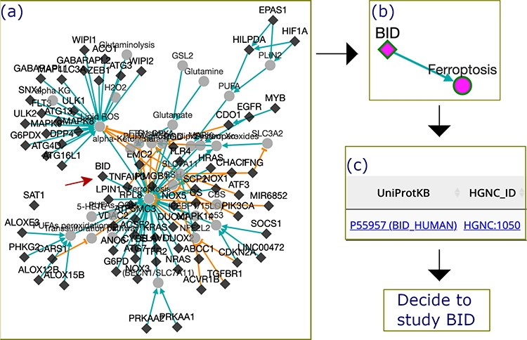
Figure 5 The process by which FerrDb was used to identify BID as a valuable gene for future study. (a) A regulation ...
Notes:
Figure 5 The process by which FerrDb was used to identify BID as a valuable gene for future study. (a) A regulation network integrating drivers’ pathways. Drivers with more than one experiment were removed from the network. (b) BID pathway in ferroptosis. (c) Links to BID resources.
Unless provided in the caption above, the following copyright applies to the content of this slide: © The Author(s) 2020. Published by Oxford University Press.This is an Open Access article distributed under the terms of the Creative Commons Attribution License (http://creativecommons.org/licenses/by/4.0/), which permits unrestricted reuse, distribution, and reproduction in any medium, provided the original work is properly cited.

