Slide 1
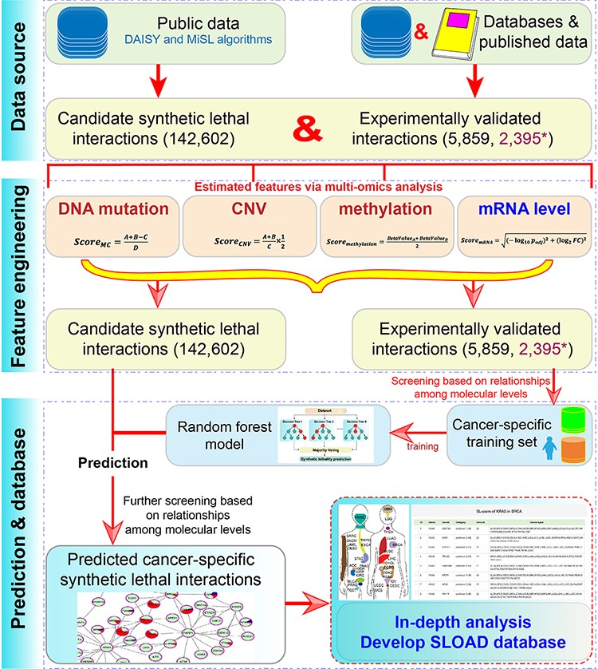
Figure 1. The main flow chart of SLOAD.
Notes:
Figure 1. The main flow chart of SLOAD. * indicates 2395 validated gene pairs without SL.
Unless provided in the caption above, the following copyright applies to the content of this slide: © The Author(s) 2022. Published by Oxford University Press.This is an Open Access article distributed under the terms of the Creative Commons Attribution-NonCommercial License (https://creativecommons.org/licenses/by-nc/4.0/), which permits non-commercial re-use, distribution, and reproduction in any medium, provided the original work is properly cited. For commercial re-use, please contact journals.permissions@oup.com

Slide 2
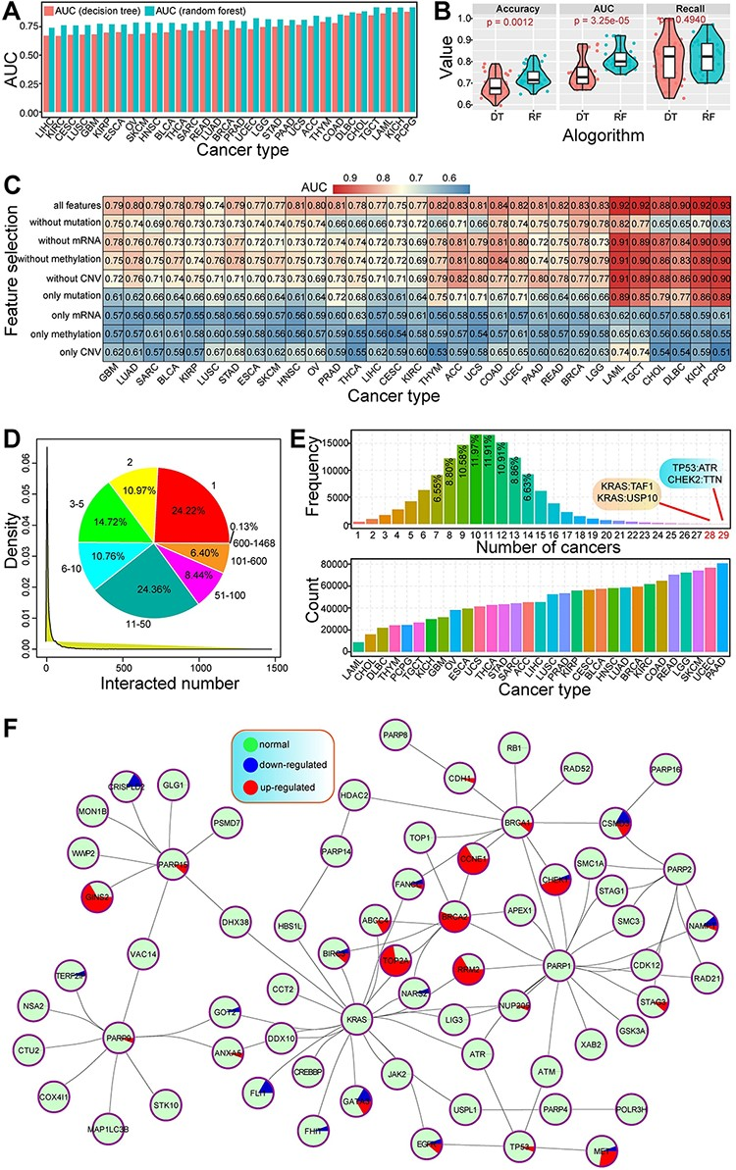
Figure 2. Primary analysis of predicted cancer-specific synthetic lethal interactions.
Notes:
Figure 2. Primary analysis of predicted cancer-specific synthetic lethal interactions. (A) The distributions of AUC values based on different algorithms (decision tree and RF). (B) Significant difference of accuracy and AUC can be detected between different algorithms DT shows decision tree algorithm, and RF shows random forest algorithm. (C) The distributions of AUC values based on different feature selections across cancers. Feature selections mainly include feature of single molecular level and integrated features from multi-omics data. (D) The distribution of interacted numbers based on all the predicted synthetic lethal interactions, and the pie distribution is also presented. (E) The number distributions of synthetic lethal interactions shared by cancers. Many of these gene pairs are shared by multiple cancers, and several gene pairs shared by more than 28 cancers are highlighted. The below picture shows that diverse cancers are detected with different numbers of genetic interactions. (F) An example of an interaction network shows genetic interactions between genes. Each circle indicates a pie distribution of expression patterns in 31 cancers.
Unless provided in the caption above, the following copyright applies to the content of this slide: © The Author(s) 2022. Published by Oxford University Press.This is an Open Access article distributed under the terms of the Creative Commons Attribution-NonCommercial License (https://creativecommons.org/licenses/by-nc/4.0/), which permits non-commercial re-use, distribution, and reproduction in any medium, provided the original work is properly cited. For commercial re-use, please contact journals.permissions@oup.com

Slide 3
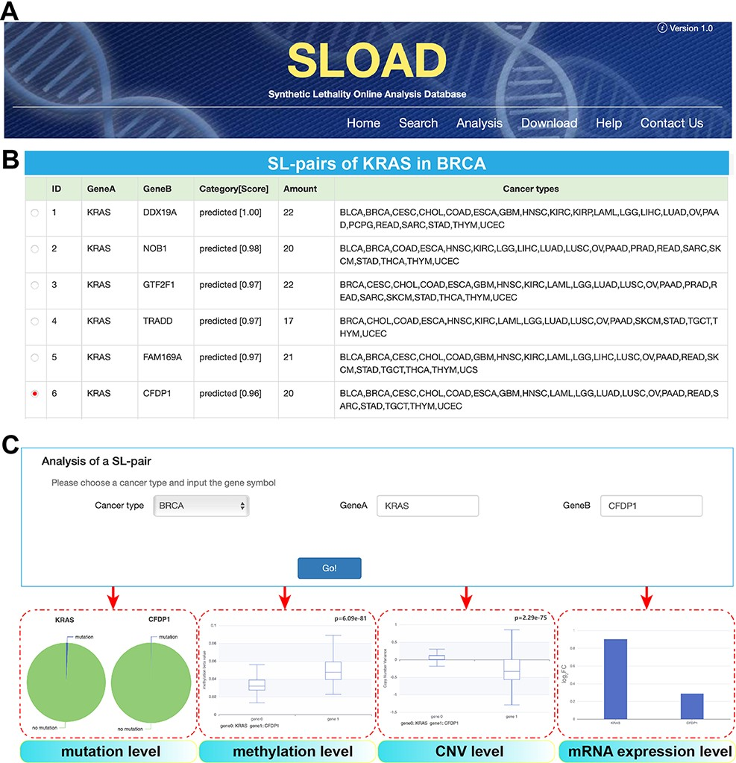
Figure 3. Overview of SLOAD database.
Notes:
Figure 3. Overview of SLOAD database. (A) Main functions of SLOAD. (B) An example of searching modules in BRCA. All of synthetic lethal interactions in BRCA can be presented, and they are also detected in other cancer types. Amount indicates the genetic interactions shared by different cancer types. Further analysis is performed based on the selected gene pair of KRAS:CFDP1. (C) An example of further analysis of above-selected gene pair of KRAS:CFDP1, mainly including visible results of mutation level, methylation level, CNV level and mRNA expression level.
Unless provided in the caption above, the following copyright applies to the content of this slide: © The Author(s) 2022. Published by Oxford University Press.This is an Open Access article distributed under the terms of the Creative Commons Attribution-NonCommercial License (https://creativecommons.org/licenses/by-nc/4.0/), which permits non-commercial re-use, distribution, and reproduction in any medium, provided the original work is properly cited. For commercial re-use, please contact journals.permissions@oup.com

