Slide 1
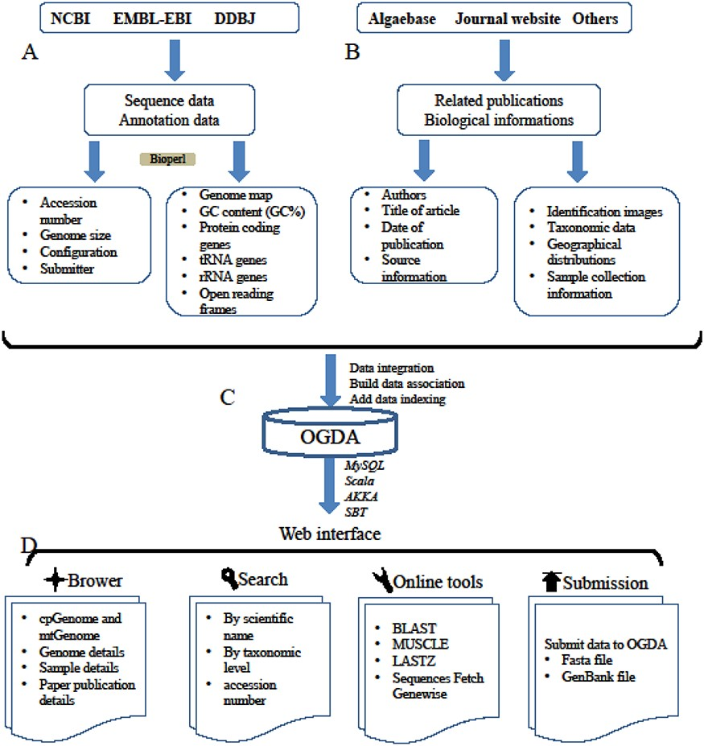
Figure 1. A schematic diagram of data processing for the OGDA database. (A) Data collection and data preprocessing. (B) ...
Notes:
Figure 1. A schematic diagram of data processing for the OGDA database. (A) Data collection and data preprocessing. (B) Collection of biological information. (C) Building data association, adding data indexing and data storage in a MySQL database. (D) Overview of the web interface and usage of OGDA.
Unless provided in the caption above, the following copyright applies to the content of this slide: © The Author(s) 2020. Published by Oxford University Press.This is an Open Access article distributed under the terms of the Creative Commons Attribution License (http://creativecommons.org/licenses/by/4.0/), which permits unrestricted reuse, distribution, and reproduction in any medium, provided the original work is properly cited.

Slide 2
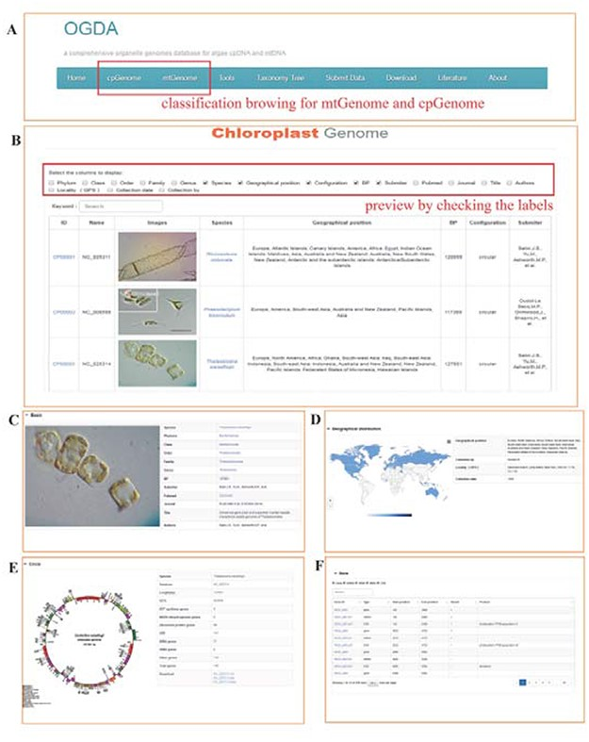
Figure 2. Screenshot of the database browser. (A) Navigation bar of the database, ‘cpGenome’ and ‘mtGenome’ can be ...
Notes:
Figure 2. Screenshot of the database browser. (A) Navigation bar of the database, ‘cpGenome’ and ‘mtGenome’ can be browsed separately. (B) Example preview results, with the following detailed genome information: (C) basic information, including identification images, taxonomy, acceptance number, genome length (bp) and published papers; (D) geographical distribution and collection information; (E) circle map of the genome and (F) coding gene display.
Unless provided in the caption above, the following copyright applies to the content of this slide: © The Author(s) 2020. Published by Oxford University Press.This is an Open Access article distributed under the terms of the Creative Commons Attribution License (http://creativecommons.org/licenses/by/4.0/), which permits unrestricted reuse, distribution, and reproduction in any medium, provided the original work is properly cited.

Slide 3
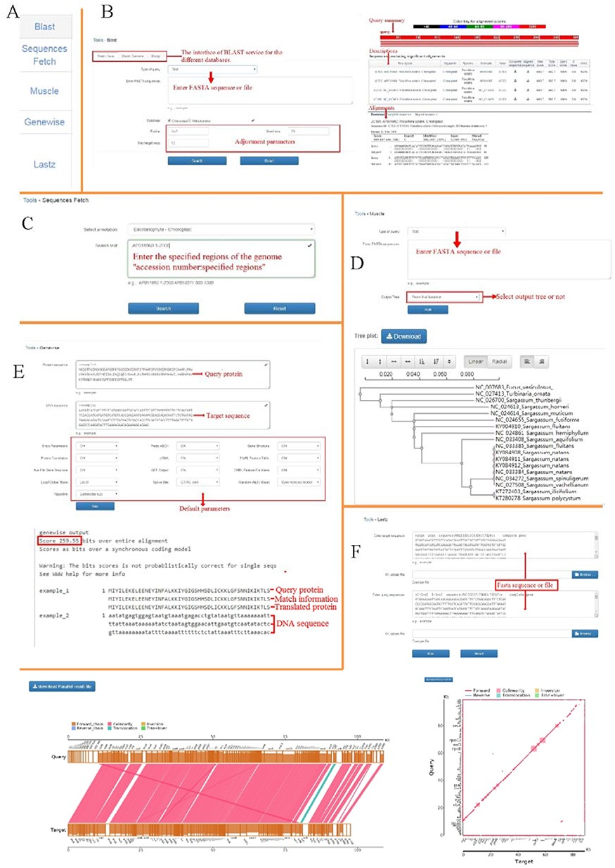
Figure 3. Functional genomics tools in OGDA. (A) Overview of genomics tools provided in OGDA. (B) Operation interface ...
Notes:
Figure 3. Functional genomics tools in OGDA. (A) Overview of genomics tools provided in OGDA. (B) Operation interface and results of BLAST tool. (C) An example of Sequences Fetch input interface. (D) Use MUSCLE to perform sequence alignment and output a physiological tree based on the maximum likelihood method. (E) Usage and result interpretation of GeneWise tool. (F) An example of genome synteny analysis by LASTZ, parallel and xoy plots are provided in the results.
Unless provided in the caption above, the following copyright applies to the content of this slide: © The Author(s) 2020. Published by Oxford University Press.This is an Open Access article distributed under the terms of the Creative Commons Attribution License (http://creativecommons.org/licenses/by/4.0/), which permits unrestricted reuse, distribution, and reproduction in any medium, provided the original work is properly cited.

